Slide 1
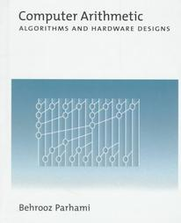
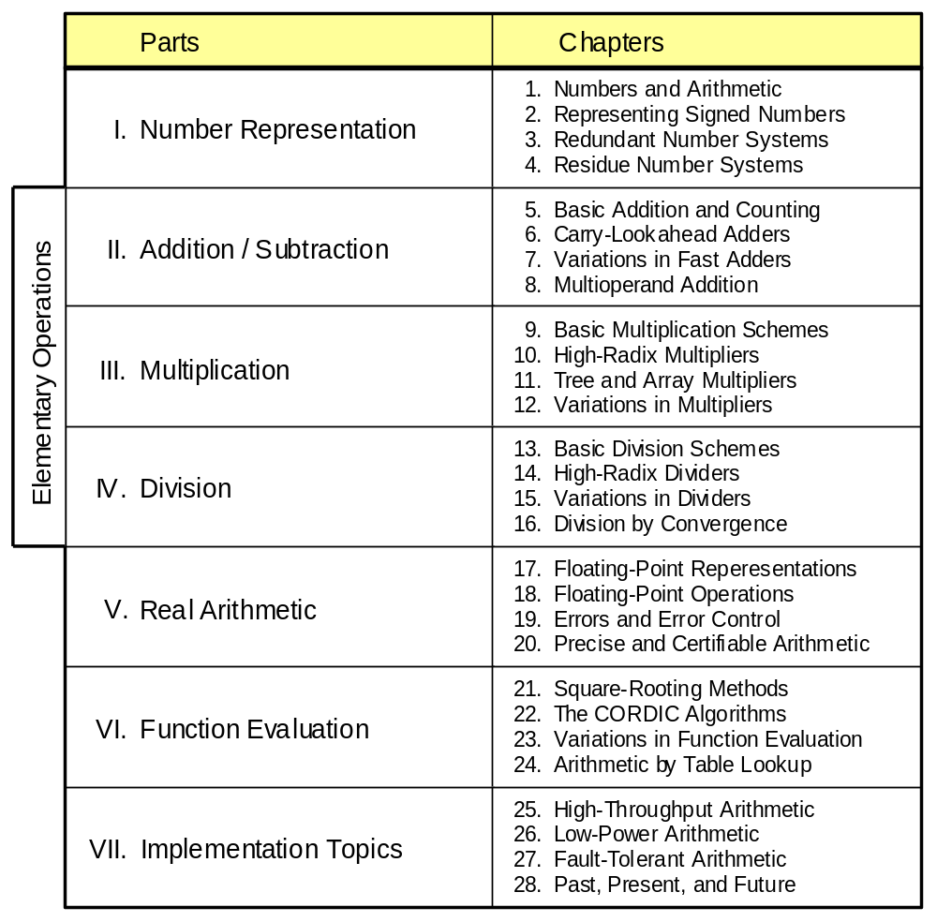
Part III
Multiplication

Slide 2
About This Presentation
This presentation is intended to support the use of the textbook Computer Arithmetic: Algorithms and Hardware Designs (Oxford University Press, 2000, ISBN 0-19-512583-5). It is updated regularly by the author as part of his teaching of the graduate course ECE 252B, Computer Arithmetic, at the University of California, Santa Barbara. Instructors can use these slides freely in classroom teaching and for other educational purposes. Unauthorized uses are strictly prohibited. © Behrooz Parhami
Edition | Released | Revised | Revised | Revised | Revised
First | Jan. 2000 | Sep. 2001 | Sep. 2003 | Oct. 2005 | May 2007

Slide 3
III Multiplication
Review multiplication schemes and various speedup methods
  Multiplication is heavily used (in arith & array indexing)
  Division = reciprocation + multiplication
  Multiplication speedup: high-radix, tree, . . .
  Bit-serial, modular, and array multipliers
Topics in This Part
Chapter 9 Basic Multiplication Schemes
Chapter 10 High-Radix Multipliers
Chapter 11 Tree and Array Multipliers
Chapter 12 Variations in Multipliers

Slide 4


“Well, well, for a rabbit, you’re not very good at multiplying, are you?”

Slide 5
9 Basic Multiplication Schemes
Chapter Goals
Study shift/add or bit-at-a-time multipliers
and set the stage for faster methods and
variations to be covered in Chapters 10-12
Chapter Highlights
Multiplication = multioperand addition
Hardware, firmware, software algorithms
Multiplying 2’s-complement numbers
The special case of one constant operand

Slide 6
Basic Multiplication Schemes: Topics
Topics in This Chapter
9.1. Shift/Add Multiplication Algorithms
9.2. Programmed Multiplication
9.3. Basic Hardware Multipliers
9.4. Multiplication of Signed Numbers
9.5. Multiplication by Constants
9.6. Preview of Fast Multipliers

Slide 7
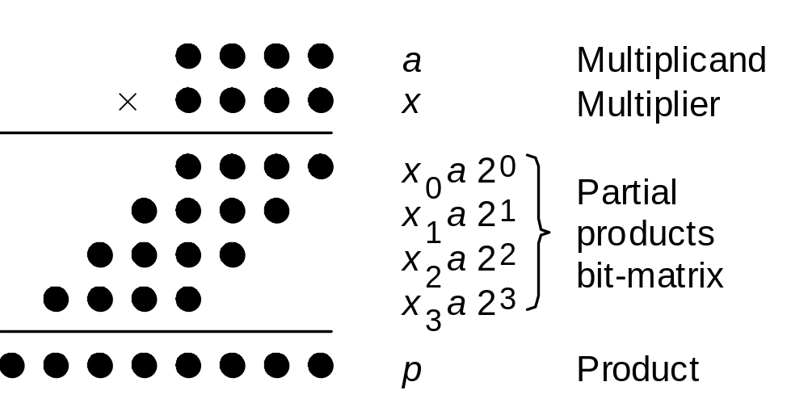
9.1 Shift/Add Multiplication Algorithms
Notation for our discussion of multiplication algorithms:
a Multiplicand a_{k–1}a_{k–2} . . . a₁a₀
x Multiplier x_{k–1}x_{k–2} . . . x₁x₀
p Product (a × x) p_{2k–1}p_{2k–2} . . . p₃p₂p₁p₀
Initially, we assume unsigned operands
Fig. 9.1 Multiplication of two 4-bit unsigned binary numbers in dot notation.

Slide 8
Multiplication Recurrence
Fig. 9.1
Preferred
Multiplication with right shifts: top-to-bottom accumulation
p^{(j+1)} = (p^{(j)} + x_{j} a 2^{k}) 2^{–1} with p⁽⁰⁾ = 0 and
|–––add–––| p^{(k)} = p = ax + p⁽⁰⁾2^{–k}
|––shift right––|
Multiplication with left shifts: bottom-to-top accumulation
p^{(j+1)} = 2 p^{(j)} + x_{k–j–1}a with p⁽⁰⁾ = 0 and
|shift| p^{(k)} = p = ax + p⁽⁰⁾2^{k}
|––––add––––|

Slide 9
Examples of Basic Multiplication
Right-shift algorithm Left-shift algorithm
======================== =======================
a 1 0 1 0 a 1 0 1 0
x 1 0 1 1 x 1 0 1 1
======================== =======================
p⁽⁰⁾ 0 0 0 0 p⁽⁰⁾ 0 0 0 0
+x₀a 1 0 1 0 2p⁽⁰⁾ 0 0 0 0 0
––––––––––––––––––––––––– +x₃a 1 0 1 0
2p⁽¹⁾ 0 1 0 1 0 ––––––––––––––––––––––––
p⁽¹⁾ 0 1 0 1 0 p⁽¹⁾ 0 1 0 1 0
+x₁a 1 0 1 0 2p⁽¹⁾ 0 1 0 1 0 0
––––––––––––––––––––––––– +x₂a 0 0 0 0
2p⁽²⁾ 0 1 1 1 1 0 ––––––––––––––––––––––––
p⁽²⁾ 0 1 1 1 1 0 p⁽²⁾ 0 1 0 1 0 0
+x₂a 0 0 0 0 2p⁽²⁾ 0 1 0 1 0 0 0
––––––––––––––––––––––––– +x₁a 1 0 1 0
2p⁽³⁾ 0 0 1 1 1 1 0 ––––––––––––––––––––––––
p⁽³⁾ 0 0 1 1 1 1 0 p⁽³⁾ 0 1 1 0 0 1 0
+x₃a 1 0 1 0 2p⁽³⁾ 0 1 1 0 0 1 0 0
––––––––––––––––––––––––– +x₀a 1 0 1 0
2p⁽⁴⁾ 0 1 1 0 1 1 1 0 ––––––––––––––––––––––––
p⁽⁴⁾ 0 1 1 0 1 1 1 0 p⁽⁴⁾ 0 1 1 0 1 1 1 0
======================== =======================
Fig. 9.2 Examples of sequential multipli-cation with right and left shifts.

Slide 10
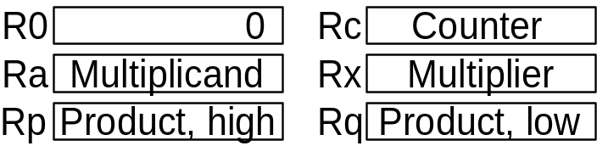
9.2 Programmed Multiplication
{Using right shifts, multiply unsigned m_cand and m_ier,
storing the resultant 2k-bit product in p_high and p_low.
Registers: R0 holds 0 Rc for counter
Ra for m_cand Rx for m_ier
Rp for p_high Rq for p_low}
{Load operands into registers Ra and Rx}
mult: load Ra with m_cand
load Rx with m_ier
{Initialize partial product and counter}
copy R0 into Rp
copy R0 into Rq
load k into Rc
{Begin multiplication loop}
m_loop: shift Rx right 1 {LSB moves to carry flag}
branch no_add if carry = 0
add Ra to Rp {carry flag is set to cout}
no_add: rotate Rp right 1 {carry to MSB, LSB to carry}
rotate Rq right 1 {carry to MSB, LSB to carry}
decr Rc {decrement counter by 1}
branch m_loop if Rc ≠ 0
{Store the product}
store Rp into p_high
store Rq into p_low
m_done: ...
Fig. 9.3 Programmed multiplication (right-shift algorithm).

Slide 11
Time Complexity of Programmed Multiplication
Assume k-bit words
k iterations of the main loop
6-7 instructions per iteration, depending on the multiplier bit
Thus, 6k + 3 to 7k + 3 machine instructions,
ignoring operand loads and result store
k = 32 implies 200⁺ instructions on average
This is too slow for many modern applications!
Microprogrammed multiply would be somewhat better

Slide 12
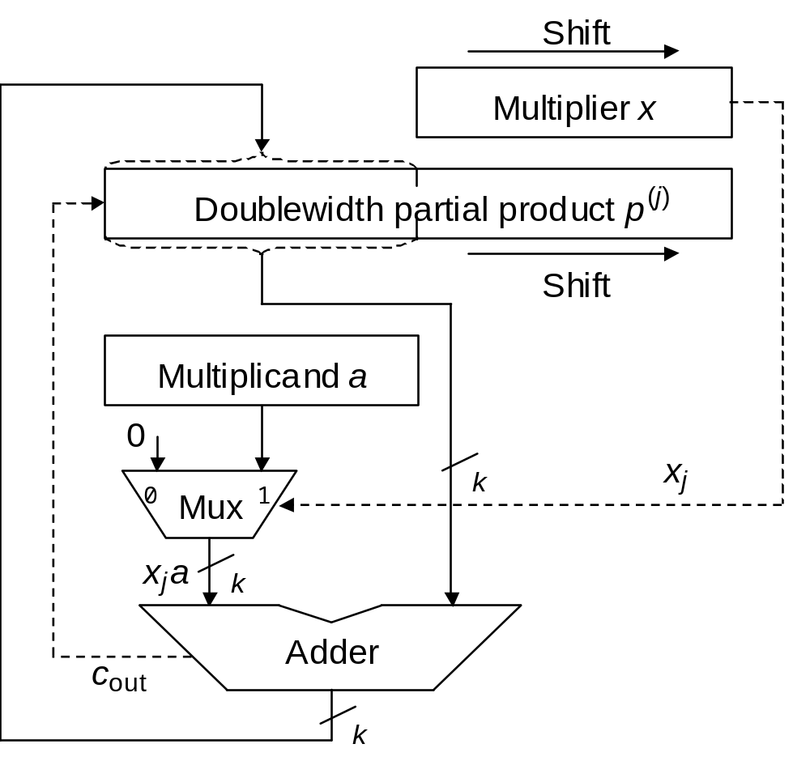
9.3 Basic Hardware Multipliers
Fig. 9.4 Hardware realization of the sequential multiplication algorithm with additions and right shifts.

Slide 13
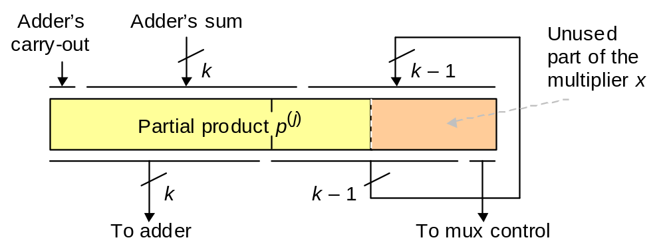
Performing Add and Shift in One Clock Cycle
Fig. 9.5 Combining the loading and shifting of the double-width register holding the partial product and the partially used multiplier.

Slide 14
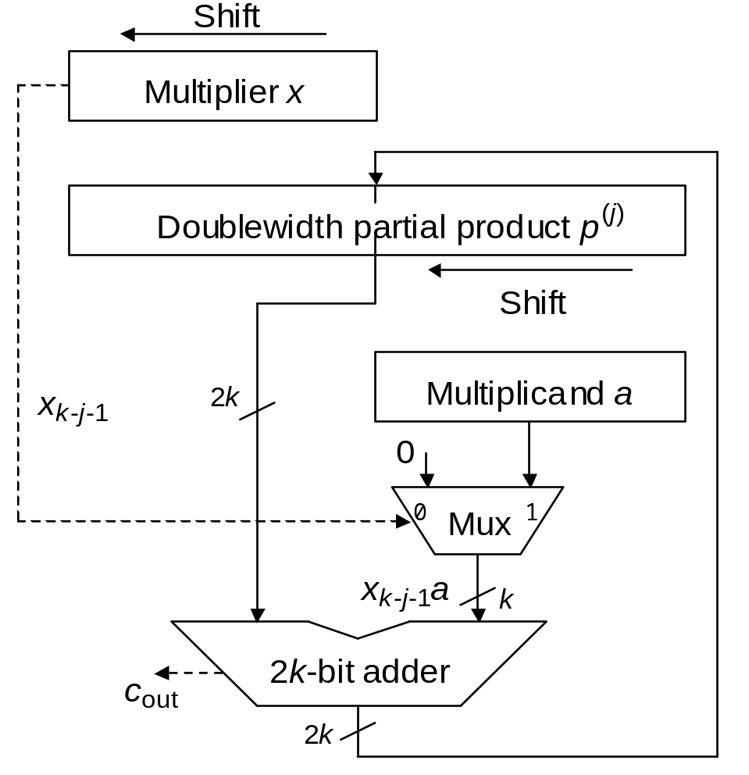
Sequential Multiplication with Left Shifts
Fig. 9.6 Hardware realization of the sequential multiplication algorithm with left shifts and additions.

Slide 15
9.4 Multiplication of Signed Numbers
============================
a 1 0 1 1 0
x 0 1 0 1 1
============================
p⁽⁰⁾ 0 0 0 0 0
+x₀a 1 0 1 1 0
–––––––––––––––––––––––––––––
2p⁽¹⁾ 1 1 0 1 1 0
p⁽¹⁾ 1 1 0 1 1 0
+x₁a 1 0 1 1 0
–––––––––––––––––––––––––––––
2p⁽²⁾ 1 1 0 0 0 1 0
p⁽²⁾ 1 1 0 0 0 1 0
+x₂a 0 0 0 0 0
–––––––––––––––––––––––––––––
2p⁽³⁾ 1 1 1 0 0 0 1 0
p⁽³⁾ 1 1 1 0 0 0 1 0
+x₃a 1 0 1 1 0
–––––––––––––––––––––––––––––
2p⁽⁴⁾ 1 1 0 0 1 0 0 1 0
p⁽⁴⁾ 1 1 0 0 1 0 0 1 0
+x₄a 0 0 0 0 0
–––––––––––––––––––––––––––––
2p⁽⁵⁾ 1 1 1 0 0 1 0 0 1 0
p⁽⁵⁾ 1 1 1 0 0 1 0 0 1 0
============================
Fig. 9.7 Sequential multiplication of
2’s-complement numbers with right shifts (positive multiplier).
Negative multiplicand,
positive multiplier:
No change, other than
looking out for proper
sign extension

Slide 16
The Case of a Negative Multiplier
============================
a 1 0 1 1 0
x 1 0 1 0 1
============================
p⁽⁰⁾ 0 0 0 0 0
+x₀a 1 0 1 1 0
–––––––––––––––––––––––––––––
2p⁽¹⁾ 1 1 0 1 1 0
p⁽¹⁾ 1 1 0 1 1 0
+x₁a 0 0 0 0 0
–––––––––––––––––––––––––––––
2p⁽²⁾ 1 1 1 0 1 1 0
p⁽²⁾ 1 1 1 0 1 1 0
+x₂a 1 0 1 1 0
–––––––––––––––––––––––––––––
2p⁽³⁾ 1 1 0 0 1 1 1 0
p⁽³⁾ 1 1 0 0 1 1 1 0
+x₃a 0 0 0 0 0
–––––––––––––––––––––––––––––
2p⁽⁴⁾ 1 1 1 0 0 1 1 1 0
p⁽⁴⁾ 1 1 1 0 0 1 1 1 0
+(−x₄a) 0 1 0 1 0
–––––––––––––––––––––––––––––
2p⁽⁵⁾ 0 0 0 1 1 0 1 1 1 0
p⁽⁵⁾ 0 0 0 1 1 0 1 1 1 0
============================
Fig. 9.8 Sequential multiplication of
2’s-complement numbers with right shifts (negative multiplier).
Negative multiplicand,
negative multiplier:
In last step (the sign bit), subtract rather than add

Slide 17
Booth’s Recoding
Table 9.1 Radix-2 Booth’s recoding
–––––––––––––––––––––––––––––––––––––
x_{i} x_{i–1} y_{i} Explanation
–––––––––––––––––––––––––––––––––––––
0 0 0 No string of 1s in sight
0 1 1 End of string of 1s in x
1 0 ⁻1 Beginning of string of 1s in x
1 1 0 Continuation of string of 1s in x
–––––––––––––––––––––––––––––––––––––
Example
1 0 0 1 1 1 0 1 1 0 1 0 1 1 1 0 Operand x
(1) ⁻1 0 1 0 0 ⁻1 1 0 ⁻1 1 ⁻1 1 0 0 ⁻1 0 Recoded version y
Justification
2^{j} + 2^{j–1} + . . . + 2^{i+1} + 2^{i} = 2^{j+1} – 2^{i}

Slide 18
Example Multiplication with Booth’s Recoding
============================
a 1 0 1 1 0
x 1 0 1 0 1 Multiplier
y ⁻1 1 ⁻1 1 ⁻1 Booth-recoded
============================
p⁽⁰⁾ 0 0 0 0 0
+y₀a 0 1 0 1 0
–––––––––––––––––––––––––––––
2p⁽¹⁾ 0 0 1 0 1 0
p⁽¹⁾ 0 0 1 0 1 0
+y₁a 1 0 1 1 0
–––––––––––––––––––––––––––––
2p⁽²⁾ 1 1 1 0 1 1 0
p⁽²⁾ 1 1 1 0 1 1 0
+y₂a 0 1 0 1 0
–––––––––––––––––––––––––––––
2p⁽³⁾ 0 0 0 1 1 1 1 0
p⁽³⁾ 0 0 0 1 1 1 1 0
+y₃a 1 0 1 1 0
–––––––––––––––––––––––––––––
2p⁽⁴⁾ 1 1 1 0 0 1 1 1 0
p⁽⁴⁾ 1 1 1 0 0 1 1 1 0
y₄a 0 1 0 1 0
–––––––––––––––––––––––––––––
2p⁽⁵⁾ 0 0 0 1 1 0 1 1 1 0
p⁽⁵⁾ 0 0 0 1 1 0 1 1 1 0
============================
Fig. 9.9 Sequential multiplication of
2’s-complement numbers with right shifts by means of Booth’s recoding.
––––––––––
x_{i} x_{i–1} y_{i}
––––––––––
0 0 0
0 1 1
1 0 ⁻1
1 1 0
––––––––––

Slide 19
9.5 Multiplication by Constants
0 1 2 . . . n – 1
Explicit, e.g. y := 12 ∗ x + 1
Implicit, e.g. A[i, j] := A[i, j] + B[i, j]
Address of A[i, j] = base + n ∗ i + j
0
1
2
.
.
.
m – 1
Row i
Column j
Software aspects:
Optimizing compilers replace multiplications by shifts/adds/subs
Produce efficient code using as few registers as possible
Find the best code by a time/space-efficient algorithm
Hardware aspects:
Synthesize special-purpose units such as filters
y[t] = a₀x[t] + a₁x[t – 1] + a₂x[t – 2] + b₁y[t – 1] + b₂y[t – 2]

Slide 20
Multiplication Using Binary Expansion
Example: Multiply R1 by the constant 113 = (1 1 1 0 0 0 1)_{two}
R2 ← R1 shift-left 1
R3 ← R2 + R1
R6 ← R3 shift-left 1
R7 ← R6 + R1
R112 ← R7 shift-left 4
R113 ← R112 + R1
Shift, add
Shift
Ri: Register that contains i times (R1)
This notation is for clarity; only one register other than R1 is needed
Shorter sequence using shift-and-add instructions
R3 ← R1 shift-left 1 + R1
R7 ← R3 shift-left 1 + R1
R113 ← R7 shift-left 4 + R1

Slide 21
Multiplication via Recoding
Example: Multiply R1 by 113 = (1 1 1 0 0 0 1)_{two} = (1 0 0⁻1 0 0 0 1)_{two}
R8 ← R1 shift-left 3
R7 ← R8 – R1
R112 ← R7 shift-left 4
R113 ← R112 + R1
Shift, add
Shift
Shift, subtract
Shorter sequence using shift-and-add/subtract instructions
R7 ← R3 shift-left 3 – R1
R113 ← R7 shift-left 4 + R1
6 shift or add (3 shift-and-add) instructions needed without recoding

Slide 22
Multiplication via Factorization
Example: Multiply R1 by 119 = 7 × 17 = (8 – 1) × (16 + 1)
R8 ← R1 shift-left 3
R7 ← R8 – R1
R112 ← R7 shift-left 4
R119 ← R112 + R7
Shorter sequence using shift-and-add/subtract instructions
R7 ← R3 shift-left 3 – R1
R119 ← R7 shift-left 4 + R7
Requires a scratch register for holding the 7 multiple
119 = (1 1 1 0 1 1 1)_{two} = (1 0 0 0⁻1 0 0⁻1)_{two}
More instructions may be needed without factorization

Slide 23
9.6 Preview of Fast Multipliers
Viewing multiplication as a multioperand addition problem,
there are but two ways to speed it up
a. Reducing the number of operands to be added:
Handling more than one multiplier bit at a time
(high-radix multipliers, Chapter 10)
b. Adding the operands faster:
Parallel/pipelined multioperand addition
(tree and array multipliers, Chapter 11)
In Chapter 12, we cover all remaining multiplication topics:
Bit-serial multipliers
Modular multipliers
Multiply-add units
Squaring as a special case

Slide 24
10 High-Radix Multipliers
Chapter Goals
Study techniques that allow us to handle
more than one multiplier bit in each cycle
(two bits in radix 4, three in radix 8, . . .)
Chapter Highlights
High radix gives rise to “difficult” multiples
Recoding (change of digit-set) as remedy
Carry-save addition reduces cycle time
Implementation and optimization methods

Slide 25
High-Radix Multipliers: Topics
Topics in This Chapter
10.1. Radix-4 Multiplication
10.2. Modified Booth’s Recoding
10.3. Using Carry-Save Adders
10.4. Radix-8 and Radix-16 Multipliers
10.5. Multibeat Multipliers
10.6. VLSI Complexity Issues

Slide 26
10.1 Radix-4 Multiplication
Fig. 9.1 (modified)
x₀ a r ⁰
x₁ a r ¹
x₂ a r ²
x₃ a r ³
Preferred
Multiplication with right shifts in radix r : top-to-bottom accumulation
p^{(j+1)} = (p^{(j)} + x_{j} a r ^{k}) r ^{–1} with p⁽⁰⁾ = 0 and
|–––add–––| p^{(k)} = p = ax + p⁽⁰⁾r ^{–k}
|––shift right––|
Multiplication with left shifts in radix r : bottom-to-top accumulation
p^{(j+1)} = r p^{(j)} + x_{k–j–1}a with p⁽⁰⁾ = 0 and
|shift| p^{(k)} = p = ax + p⁽⁰⁾r ^{k}
|––––add––––|

Slide 27
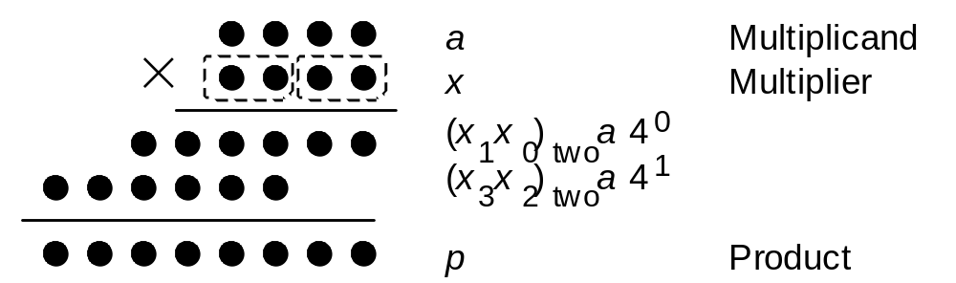
Radix-4 Multiplication in Dot Notation
Fig. 10.1 Radix-4, or two-bit-at-a-time, multiplication in dot notation
Fig. 9.1
Number of cycles is halved, but now the “difficult” multiple 3a must be dealt with

Slide 28
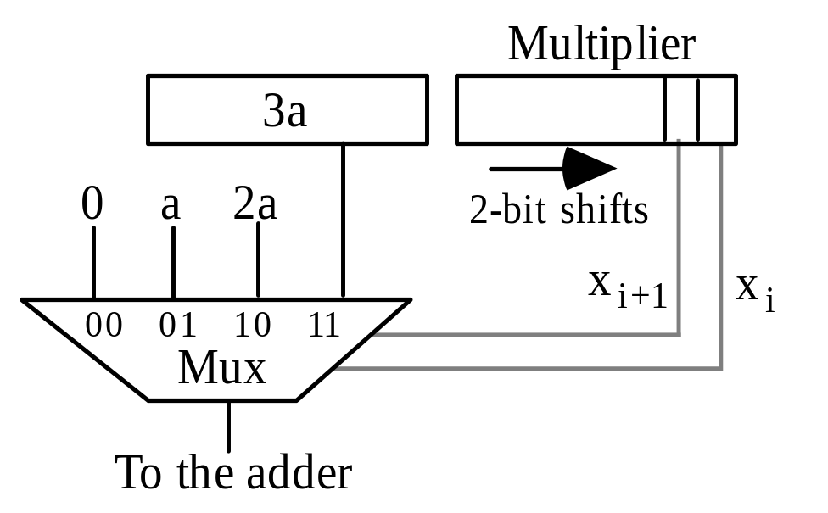
A Possible Design for a Radix-4 Multiplier
Precomputed via shift-and-add
(3a = 2a + a)
k + 1 cycles, rather than k
One extra cycle not too bad, but we would like to avoid it
if possible
Solving this problem for radix 4 may also help when dealing with even higher radices
Fig. 10.2 The multiple generation part of a radix-4 multiplier with precomputation of 3a.

Slide 29
Example Radix-4 Multiplication Using 3a
================================
a 0 1 1 0
3a 0 1 0 0 1 0
x 1 1 1 0
================================
p⁽⁰⁾ 0 0 0 0
+(x₁x₀)_{two}a 0 0 1 1 0 0
–––––––––––––––––––––––––––––––––
4p⁽¹⁾ 0 0 1 1 0 0
p⁽¹⁾ 0 0 1 1 0 0
+(x₃x₂)_{two}a 0 1 0 0 1 0
–––––––––––––––––––––––––––––––––
4p⁽²⁾ 0 1 0 1 0 1 0 0
p⁽²⁾ 0 1 0 1 0 1 0 0
================================
Fig. 10.3 Example of radix-4 multiplication using the 3a multiple.

Slide 30
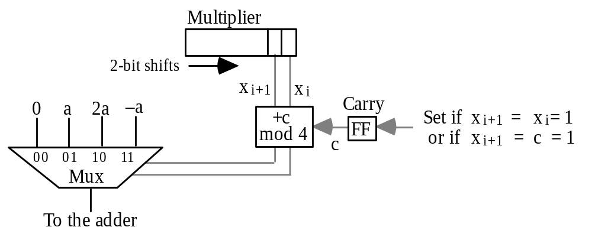
A Second Design for a Radix-4 Multiplier
Fig. 10.4 The multiple generation part of a radix-4 multiplier based on replacing 3a with 4a (carry into next higher radix-4 multiplier digit) and –a.
c
x_{i+1}(x_{i} ∨ c)
x_{i+1} ⊕ x_{i} c
x_{i} ⊕ c
x_{i+1} x_{i} c Mux control Set carry
---- --- --- ---------------- ------------
0 0 0 0 0 0
0 0 1 0 1 0
0 1 0 0 1 0
0 1 1 1 0 0
1 0 0 1 0 0
1 0 1 1 1 1
1 1 0 1 1 1
1 1 1 0 0 1

Slide 31
10.2 Modified Booth’s Recoding
Table 10.1 Radix-4 Booth’s recoding yielding (z_{k/2} . . . z₁z₀)_{four}
–––––––––––––––––––––––––––––––––––––––––––––––––––––––––––––––––
x_{i+1} x_{i} x_{i–1} y_{i+1} y_{i} z_{i/2} Explanation
–––––––––––––––––––––––––––––––––––––––––––––––––––––––––––––––––
0 0 0 0 0 0 No string of 1s in sight
0 0 1 0 1 1 End of string of 1s
0 1 0 0 1 1 Isolated 1
0 1 1 1 0 2 End of string of 1s
1 0 0 ⁻1 0 ⁻2 Beginning of string of 1s
1 0 1 ⁻1 1 ⁻1 End a string, begin new one
1 1 0 0 ⁻1 ⁻1 Beginning of string of 1s
1 1 1 0 0 0 Continuation of string of 1s
–––––––––––––––––––––––––––––––––––––––––––––––––––––––––––––––––
Recoded radix-2 digits
Context
Radix-4 digit
Example
1 0 0 1 1 1 0 1 1 0 1 0 1 1 1 0 Operand x
(1) ⁻1 0 1 0 0 ⁻1 1 0 ⁻1 1 ⁻1 1 0 0 ⁻1 0 Recoded version y
(1) ⁻2 2 ⁻1 2 ⁻1 ⁻1 0 ⁻2 Radix-4 version z

Slide 32
Example Multiplication via Modified Booth’s Recoding
================================
a 0 1 1 0
x 1 0 1 0
z ⁻1 ⁻2 Radix-4
================================
p⁽⁰⁾ 0 0 0 0 0 0
+z₀a 1 1 0 1 0 0
–––––––––––––––––––––––––––––––––
4p⁽¹⁾ 1 1 0 1 0 0
p⁽¹⁾ 1 1 1 1 0 1 0 0
+z₁a 1 1 1 0 1 0
–––––––––––––––––––––––––––––––––
4p⁽²⁾ 1 1 0 1 1 1 0 0
p⁽²⁾ 1 1 0 1 1 1 0 0
================================
Fig. 10.5 Example of radix-4 multiplication with modified Booth’s recoding of the 2’s-complement multiplier.

Slide 33
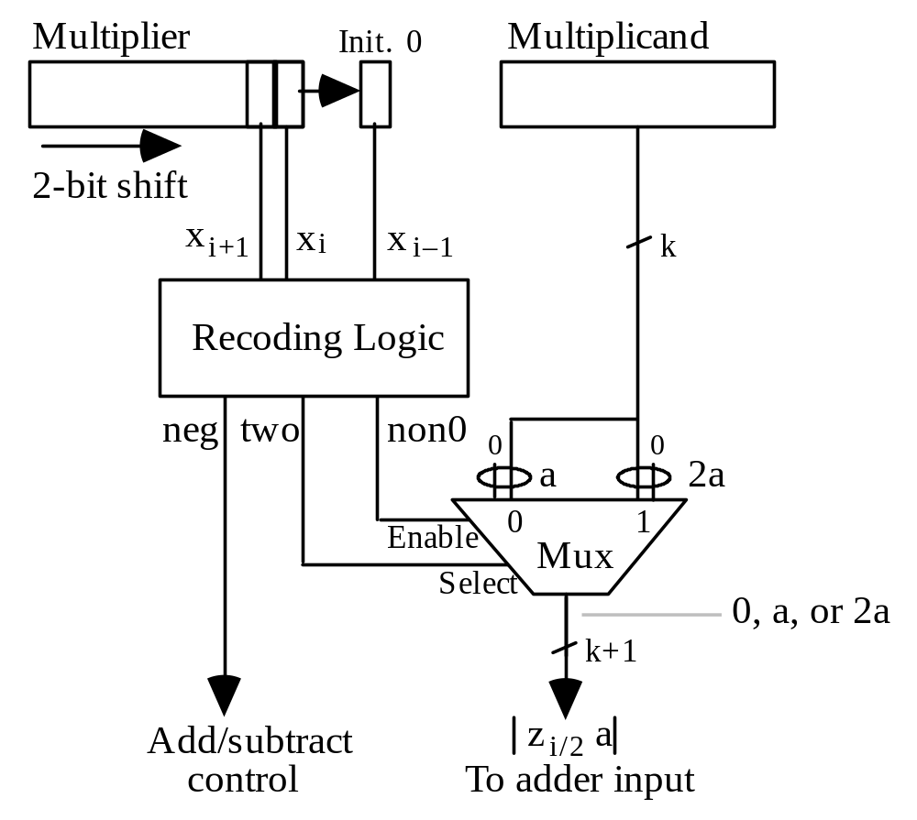
Multiple Generation with Radix-4 Booth’s Recoding
Sign extension, not 0
Could have named
this signal one/two
Fig. 10.6 The multiple generation part of a radix-4 multiplier based on Booth’s recoding.

Slide 34
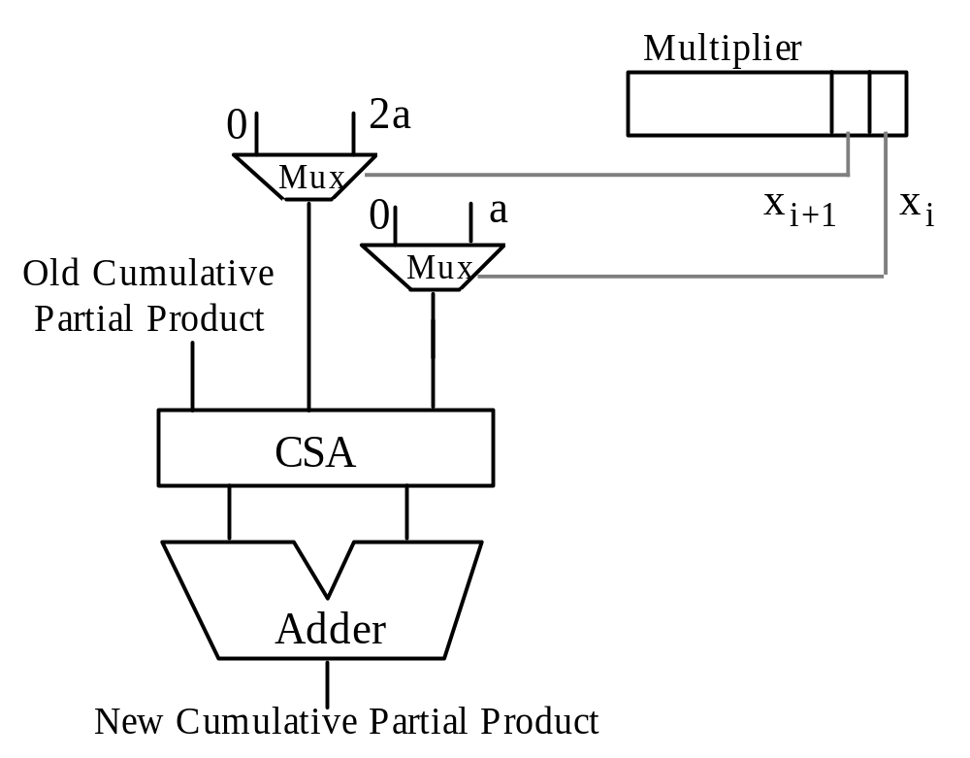
10.3 Using Carry-Save Adders
Fig. 10.7 Radix-4 multiplication with a carry-save adder used to combine the cumulative partial product, x_{i}a, and 2x_{i+1}a into two numbers.

Slide 35
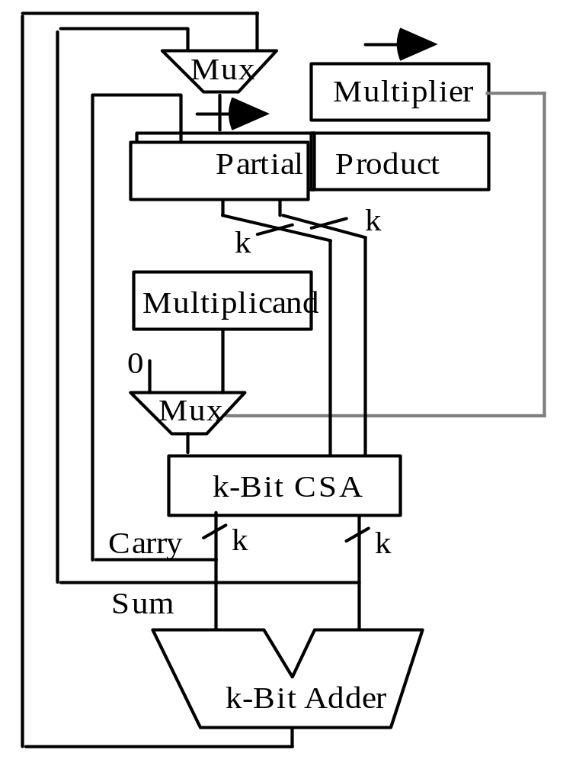
Keeping the Partial Product in Carry-Save Form
Old PP
Next multiple
Shift
CS sum
New PP
Fig. 10.8 Radix-2 multiplication with the upper half of the cumulative partial product in stored-carry form.

Slide 36
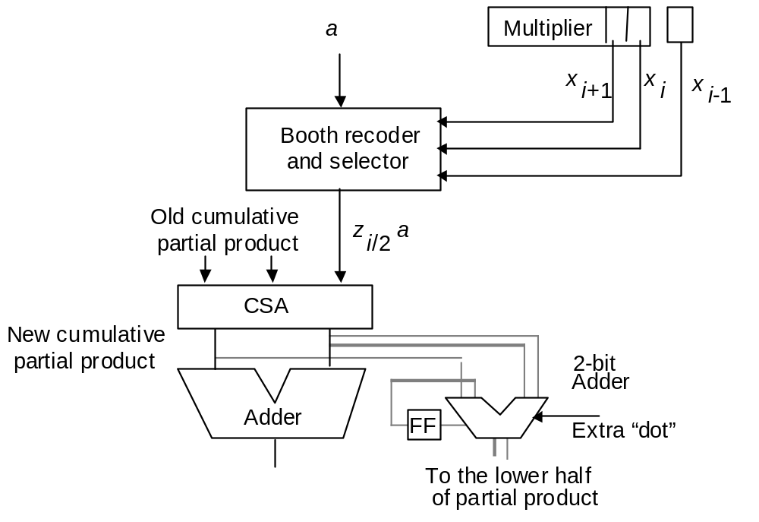
Carry-Save Multiplier with Radix-4 Booth’s Recoding
Fig. 10.9 Radix-4 multiplication with a carry-save adder used to combine the stored-carry cumulative partial product and zi/2a into two numbers.

Slide 37
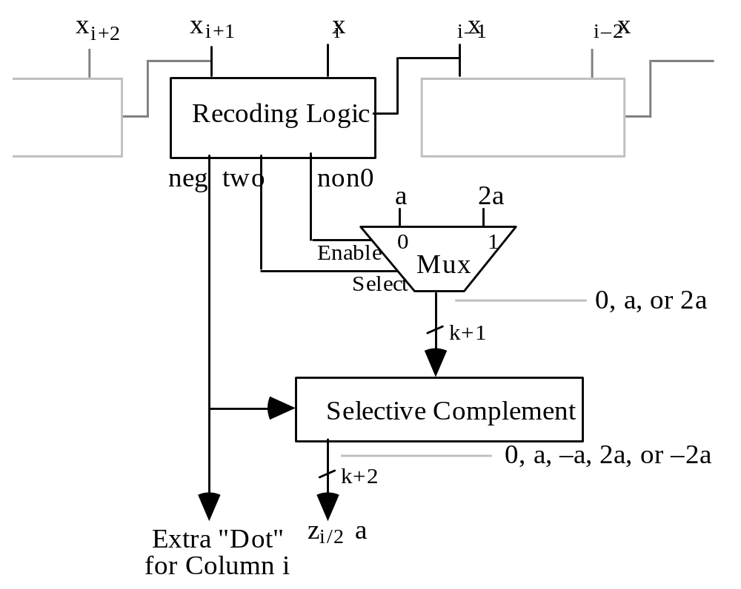
Radix-4 Booth’s Recoding for Parallel Multiplication
Fig. 10.10 Booth recoding and multiple selection logic for
high-radix or parallel multiplication.

Slide 38
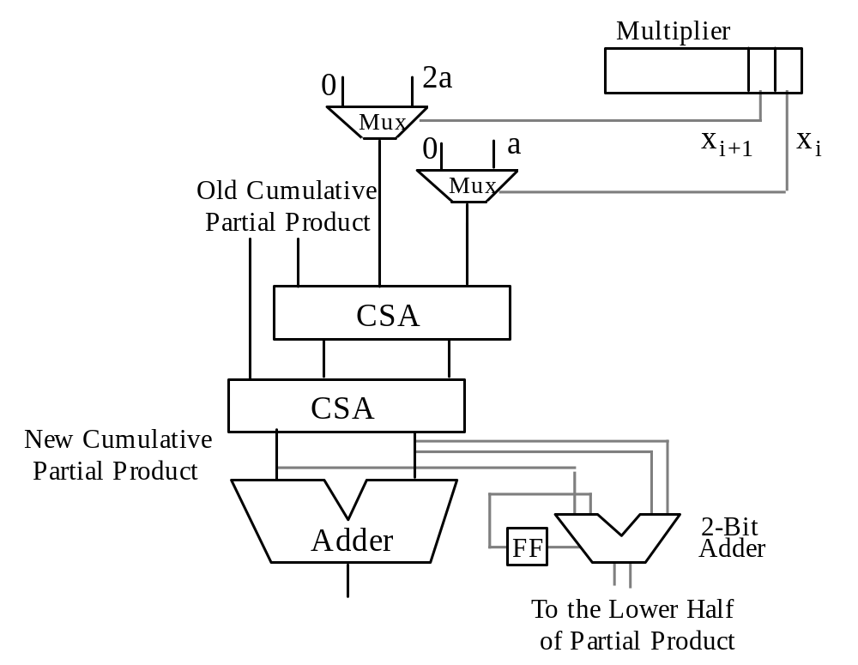
Yet Another Design for Radix-4 Multiplication
Fig. 10.11 Radix-4 multiplication with two carry-save adders.

Slide 39
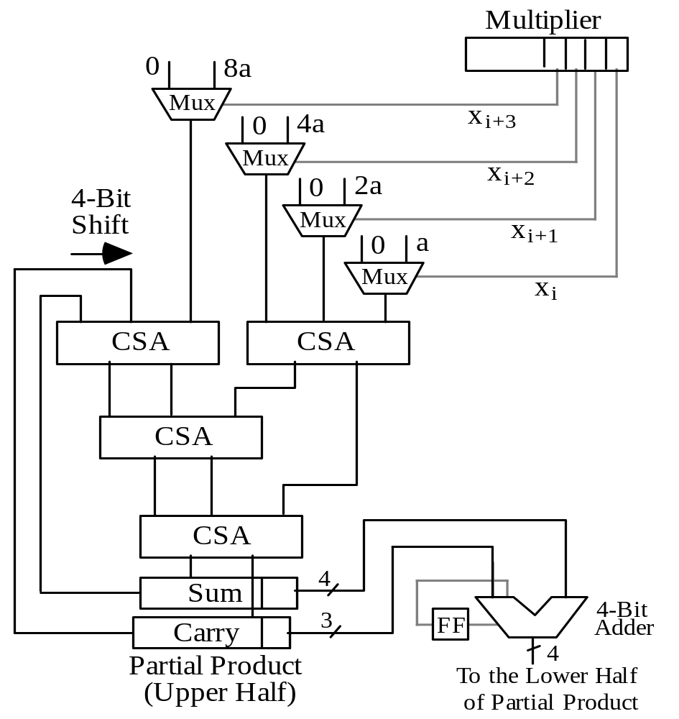
10.4 Radix-8 and Radix-16 Multipliers
4-bit
right
shift
Fig. 10.12 Radix-16 multiplication with the upper half of the cumulative partial product in carry-save form.

Slide 40
Other High-Radix Multipliers
Remove this mux & CSA and replace the 4-bit shift (adder) with a 3-bit shift (adder) to get a radix-8 multiplier (cycle time will remain the same, though)
A radix-16 multiplier design becomes a radix-256 multiplier if radix-4 Booth’s recoding is applied first
(the muxes are replaced by Booth recoding and multiple selection logic)
Fig. 10.12

Slide 41
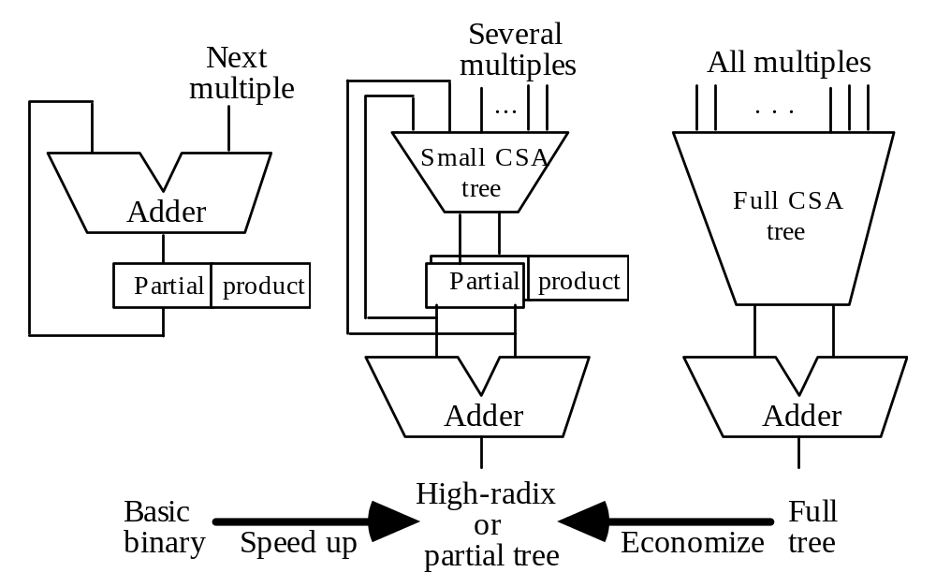
A Spectrum of Multiplier Design Choices
Fig. 10.13 High-radix multipliers as intermediate between sequential radix-2 and full-tree multipliers.

Slide 42
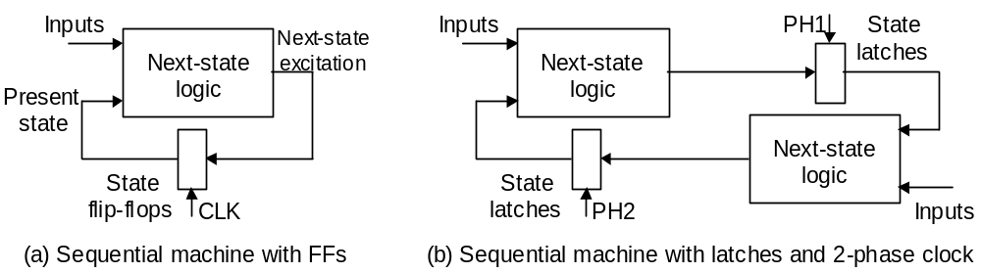
10.5 Multibeat Multipliers
Conceptual view of a twin-beat multiplier.
Begin changing FF contents
Change becomes visible at FF output
Observation: Half of the clock cycle goes to waste
Once cycle

Slide 43
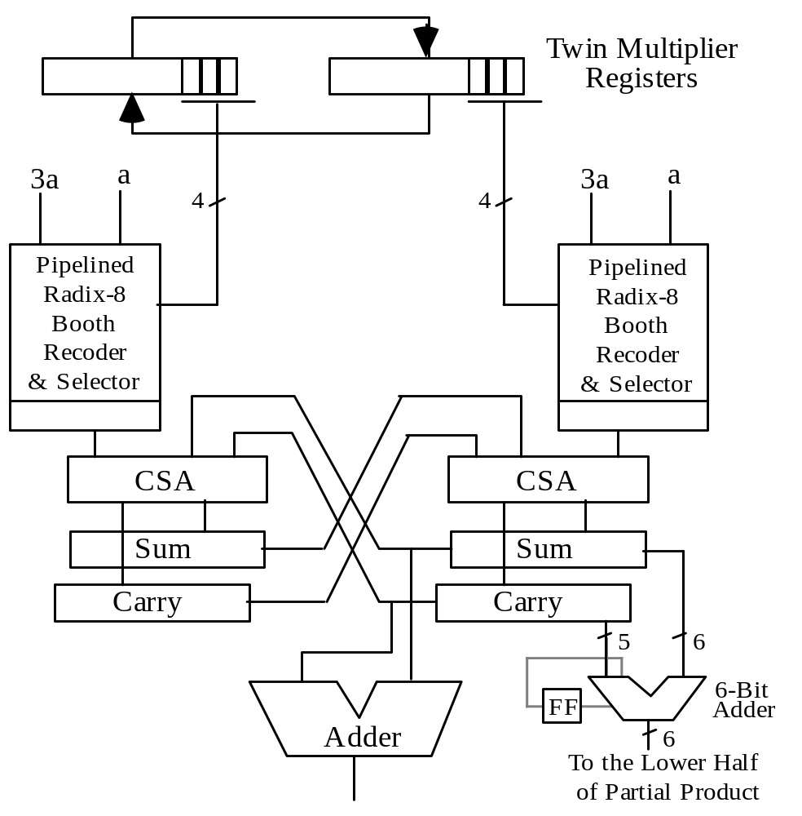
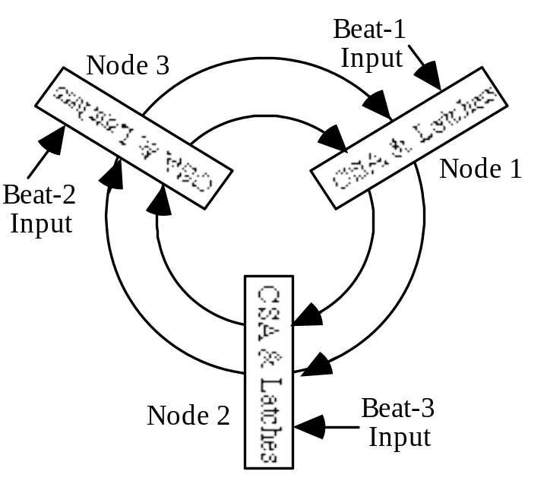
Twin-Beat and Three-Beat Multipliers
This radix-64 multiplier runs at the clock rate of a radix-8 design (2X speed)
Fig. 10.14 Twin-beat multiplier with radix-8 Booth’s recoding.
Fig. 10.15 Conceptual view of a three-beat multiplier.

Slide 44
10.6 VLSI Complexity Issues
A radix-2^{b} multiplier requires:
bk two-input AND gates to form the partial products bit-matrix
O(bk) area for the CSA tree
At least Θ(k) area for the final carry-propagate adder
Total area: A = O(bk)
Latency: T = O((k/b) log b + log k)
Any VLSI circuit computing the product of two k-bit integers must satisfy the following constraints:
AT grows at least as fast as k^{3/2}
AT² is at least proportional to k²
The preceding radix-2^{b} implementations are suboptimal, because:
AT = O(k² log b + bk log k)
AT² = O((k³/b) log²b)

Slide 45
Comparing High- and Low-Radix Multipliers
AT = O(k² log b + bk log k) AT ² = O((k³/b) log²b)
 | Low-Cost b = O(1) | High Speed b = O(k) | AT- or AT ²- Optimal
AT | O(k ²) | O(k ² log k) | O(k ^{3/2})
AT ² | O(k ³) | O(k ² log² k) | O(k ²)
Intermediate designs do not yield better AT or AT ² values;
The multipliers remain asymptotically suboptimal for any b
By the AT measure (indicator of cost-effectiveness), slower radix-2 multipliers are better than high-radix or tree multipliers
Thus, when an application requires many independent multiplications, it is more cost-effective to use a large number of slower multipliers
High-radix multiplier latency can be reduced from O((k/b) log b + log k) to O(k/b + log k) through more effective pipelining (Chapter 11)

Slide 46
11 Tree and Array Multipliers
Chapter Goals
Study the design of multipliers for highest
possible performance (speed, throughput)
Chapter Highlights
Tree multiplier = reduction tree
+ redundant-to-binary converter
Avoiding full sign extension in multiplying
signed numbers
Array multiplier = one-sided reduction tree
+ ripple-carry adder

Slide 47
Tree and Array Multipliers: Topics
Topics in This Chapter
11.1. Full-Tree Multipliers
11.2. Alternative Reduction Trees
11.3. Tree Multipliers for Signed Numbers
11.4. Partial-Tree Multipliers
11.5. Array Multipliers
11.6. Pipelined Tree and Array Multipliers

Slide 48
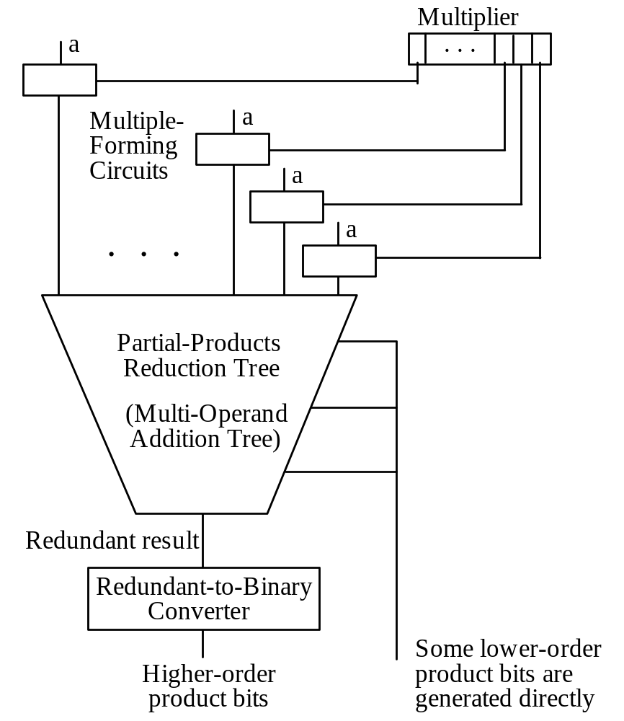
11.1 Full-Tree Multipliers
Fig. 10.13 High-radix multipliers as intermediate between sequential radix-2 and full-tree multipliers.
Fig. 11.1 General structure of a full-tree multiplier.

Slide 49
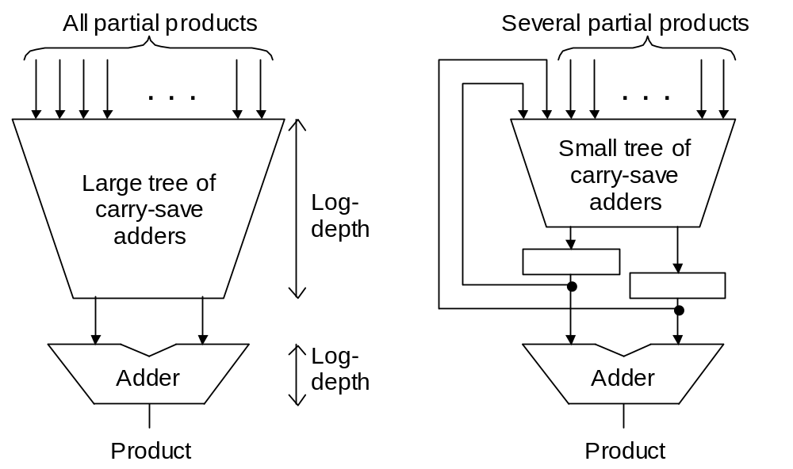
Full-Tree versus Partial-Tree Multiplier
Schematic diagrams for full-tree and partial-tree multipliers.

Slide 50
Variations in Full-Tree Multiplier Design
Designs are distinguished by
variations in three elements:
1. Multiple-forming circuits
2. Partial products reduction tree
Fig. 11.1
3. Redundant-to-binary converter

Slide 51
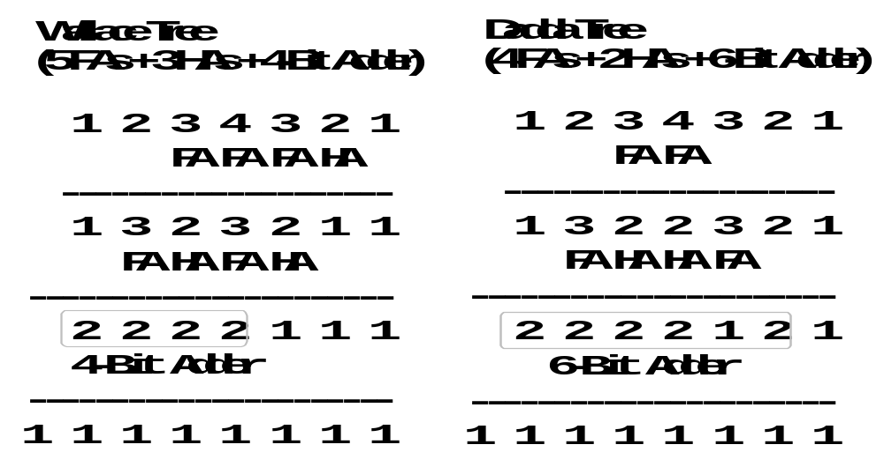
Example of Variations in CSA Tree Design
Fig. 11.2 Two different binary 4 × 4 tree multipliers.

Slide 52
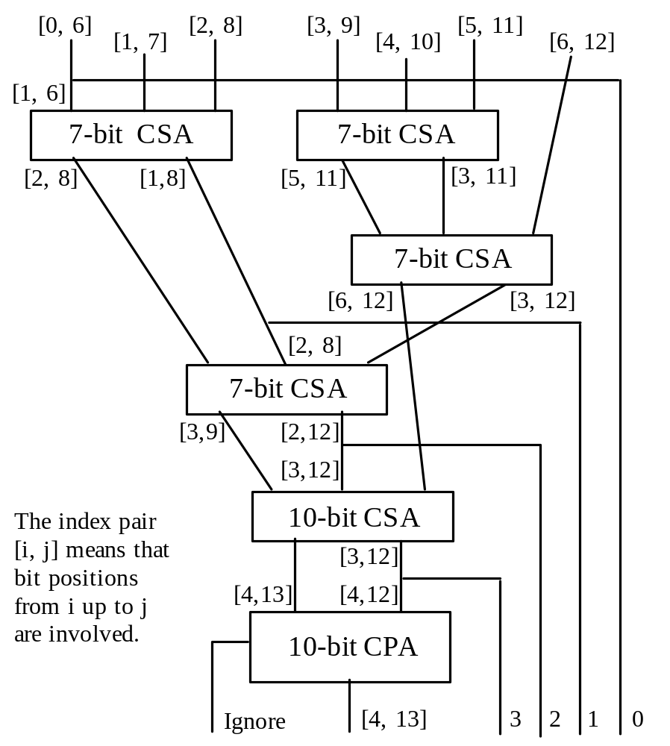
Details of a CSA Tree
Fig. 11.3 Possible CSA tree for a 7 × 7 tree multiplier.
CSA trees are quite irregular, causing some difficulties in VLSI realization
Thus, our motivation to examine alternate methods for partial products reduction

Slide 53
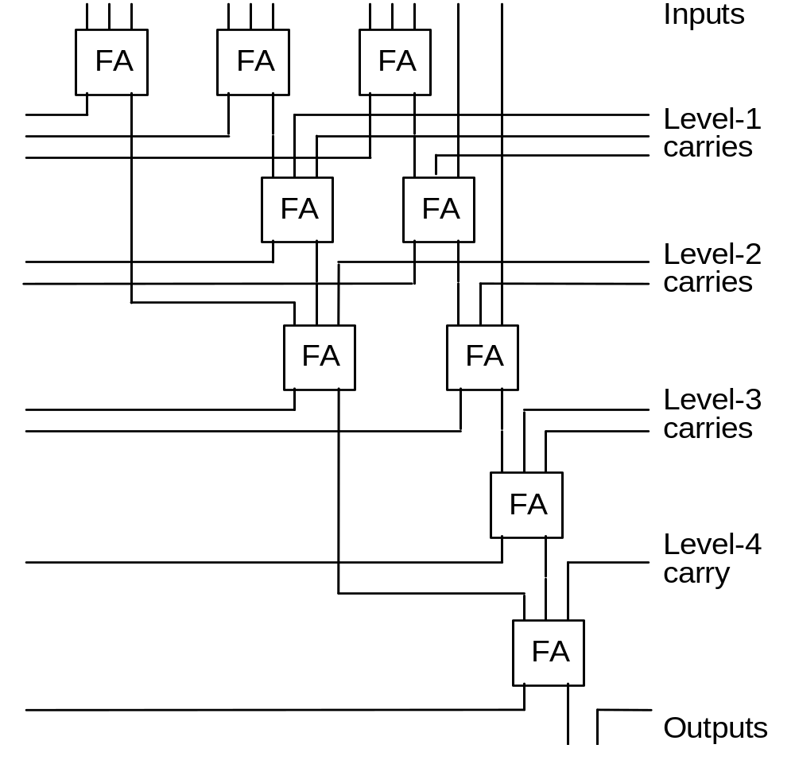
11.2 Alternative Reduction Trees
FA
FA
FA
11 + ψ₁ = 2ψ₁ + 3
Therefore, ψ₁ = 8 carries are needed
FA
FA
FA
Fig. 11.4
A slice of a balanced-delay tree for 11 inputs.
FA
FA
FA

Slide 54
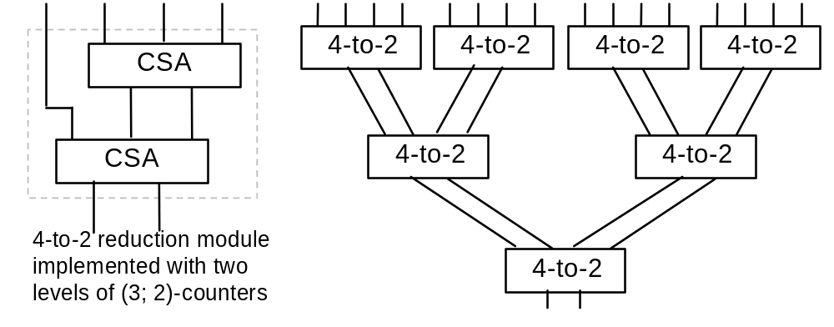
Binary Tree of 4-to-2 Reduction Modules
Fig. 11.5 Tree multiplier with a more regular structure based on 4-to-2 reduction modules.
Due to its recursive structure, a binary tree is more regular than a 3-to-2 reduction tree when laid out in VLSI

Slide 55
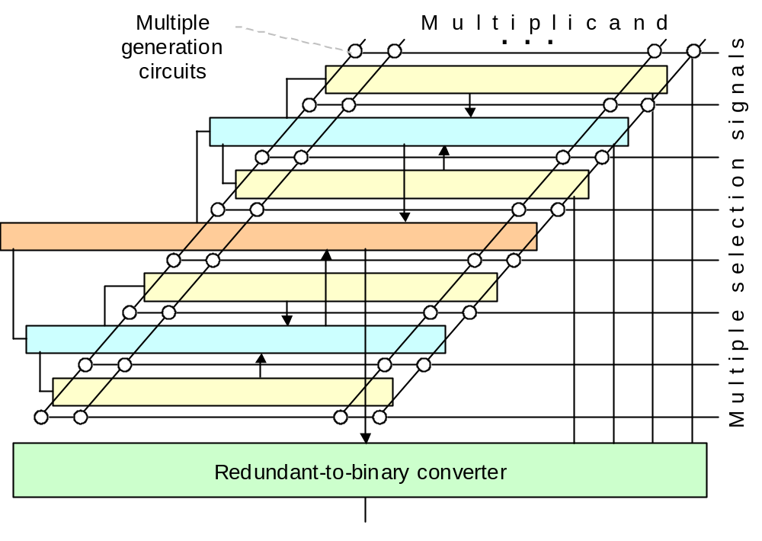
Example Multiplier with 4-to-2 Reduction Tree
Even if 4-to-2 reduction is implemented using two CSA levels, design regularity potentially makes up for the larger number of logic levels
Similarly, using Booth’s recoding may not yield any advantage, because it introduces irregularity
Fig. 11.6 Layout of a partial-products reduction tree composed of 4-to-2 reduction modules. Each solid arrow represents two numbers.

Slide 56
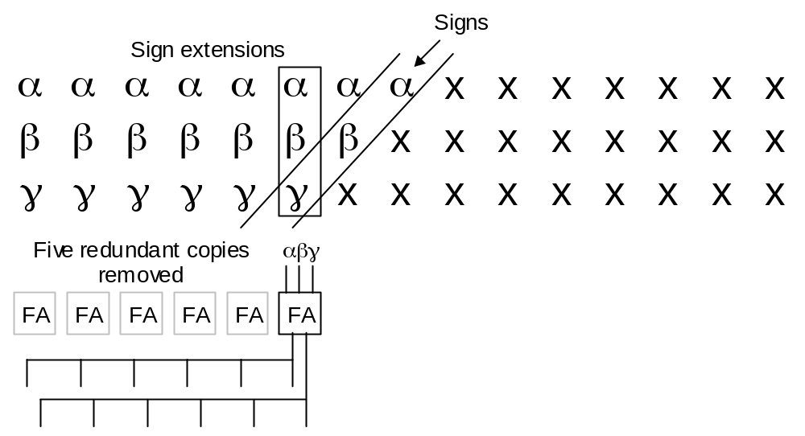
11.3 Tree Multipliers for Signed Numbers
---------- Extended positions ---------- Sign Magnitude positions ---------
x_{k–1} x_{k–1} x_{k–1} x_{k–1} x_{k–1} x_{k–1} x_{k–2} x_{k–3} x_{k–4} . . .
y_{k–1} y_{k–1} y_{k–1} y_{k–1} y_{k–1} y_{k–1} y_{k–2} y_{k–3} y_{k–4} . . .
z_{k–1} z_{k–1} z_{k–1} z_{k–1} z_{k–1} z_{k–1} z_{k–2} z_{k–3} z_{k–4} . . .
From Fig. 8.18 Sign extension in multioperand addition.
The difference in multiplication is the shifting sign positions
Fig. 11.7 Sharing of full adders to reduce the CSA width in a signed tree multiplier.

Slide 57
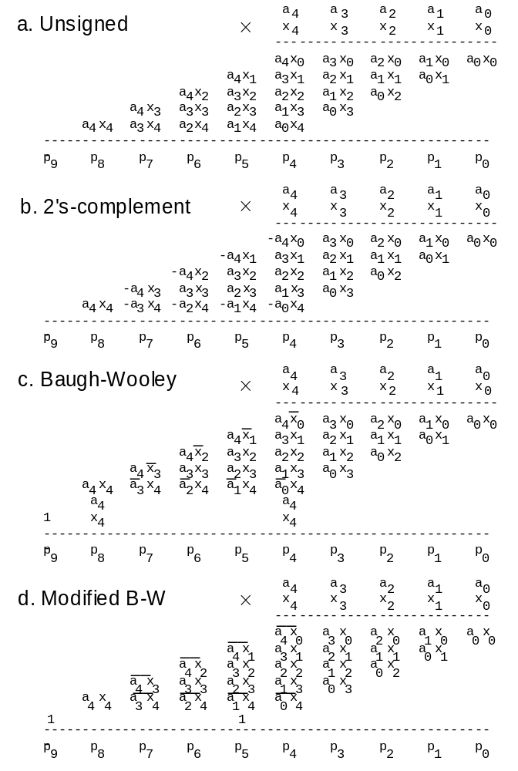
Using the Negative-Weight Property of the Sign Bit
Sign extension is a way of converting negatively weighted bits (negabits) to positively weighted bits (posibits) to facilitate reduction, but there are other methods of accomplishing the same without introducing a lot of extra bits
Baugh and Wooley have contributed two such methods
Fig. 11.8 Baugh-Wooley
2’s-complement multiplication.

Slide 58
The Baugh-Wooley Method and Its Modified Form
Fig. 11.8
–a₄x₀ = a₄(1 – x₀) – a₄
= a₄x₀′ – a₄
–a₄ a₄x₀′
a₄
In next column
–a₄x₀ = (1 – a₄x₀) – 1
= (a₄x₀)′ – 1
–1 (a₄x₀)′
1
In next column

Slide 59
Alternate Views of the Baugh-Wooley Methods
+ 0 0 –a₄x₃ –a₄x₂ –a₄x₁ –a₄x₀
+ 0 0 –a₃x₄ –a₂x₄ –a₁x₄ –a₀x₄
--------------------------------------------
– 0 0 a₄x₃ a₄x₂ a₄x₁ a₄x₀
– 0 0 a₃x₄ a₂x₄ a₁x₄ a₀x₄
--------------------------------------------
+ 1 1 a₄x₃ a₄x₂ a₄x₁ a₄x₀
+ 1 1 a₃x₄ a₂x₄ a₁x₄ a₀x₄
1
1
--------------------------------------------
+ a₄ a₄ a₄x₃ a₄x₂ a₄x₁ a₄x₀
+ x₄ x₄ a₃x₄ a₂x₄ a₁x₄ a₀x₄
a₄
x₄
--------------------------------------------
a₄
1 x₄

Slide 60
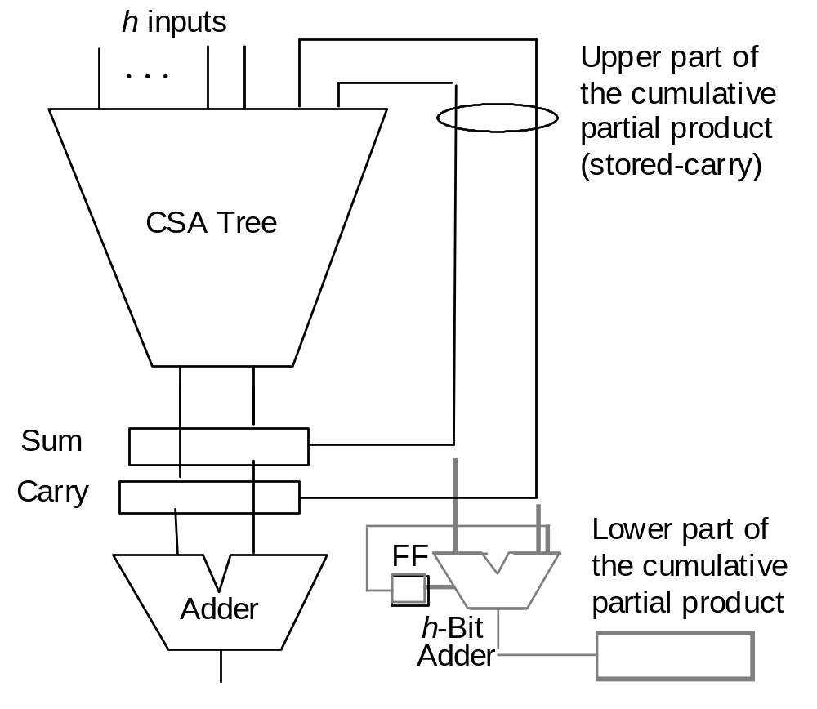
11.4 Partial-Tree and Truncated Multipliers
High-radix versus partial-tree multipliers: The difference is quantitative, not qualitative
For small h, say ≤ 8 bits,
we view the multiplier of
Fig. 11.9 as high-radix
When h is a significant fraction of k, say k/2 or k/4,
then we tend to view it as
a partial-tree multiplier
Better design through pipelining
to be covered in Section 11.6
Fig. 11.9 General structure of a partial-tree multiplier.

Slide 61
Why Truncated Multipliers?
Nearly half of the hardware in array/tree multipliers is there to get the last bit right (1 dot = one FPGA cell)
ulp
. o o o o o o o o k-by-k fractional
× . o o o o o o o o multiplication
---------------------------------
. o o o o o o o|o
. o o o o o o|o o
. o o o o o|o o o
. o o o o|o o o o
. o o o|o o o o o
. o o|o o o o o o
. o|o o o o o o o
. |o o o o o o o o
---------------------------------
. o o o o o o o o|o o o o o o o o
Max error = 8/2 + 7/4
+ 6/8 + 5/16 + 4/32
+ 3/64 + 2/128
+ 1/256 = 7.004 ulp
Mean error =
1.751 ulp
Removing the dots at the right does not lead to much loss of precision.

Slide 62
Truncated Multipliers with Error Compensation
We can introduce additional “dots” on the left-hand side to compensate for the removal of dots from the right-hand side
Constant compensation Variable compensation
. o o o o o o o| . o o o o o o o|
. o o o o o o| . o o o o o o|
. o o o o o| . o o o o o|
. o o o o| . o o o o|
. o o o| . o o o|
. 1 o o| . o o|
. o| . x₋₁o|
. | . y₋₁ |
Constant and variable error compensation for truncated multipliers.
Max error = +4 ulp
Max error ≅ −3 ulp
Max error = +? ulp
Max error ≅ −? ulp
Mean error = ? ulp
Mean error = ? ulp

Slide 63
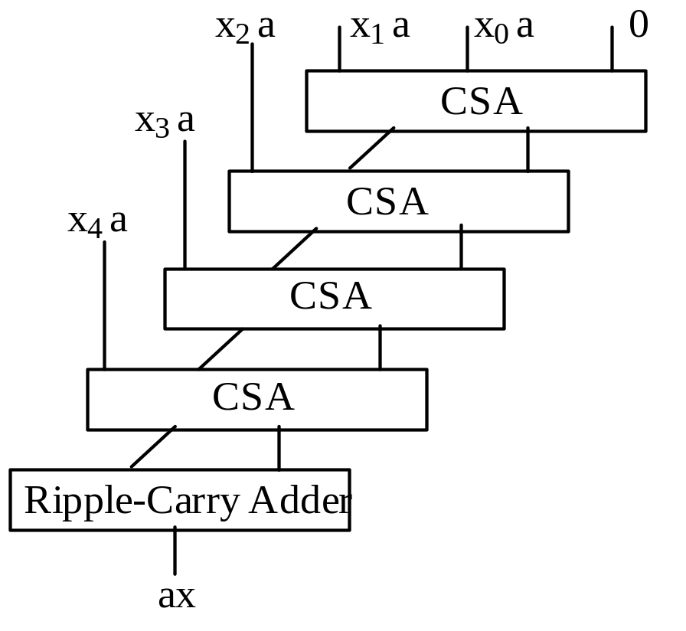
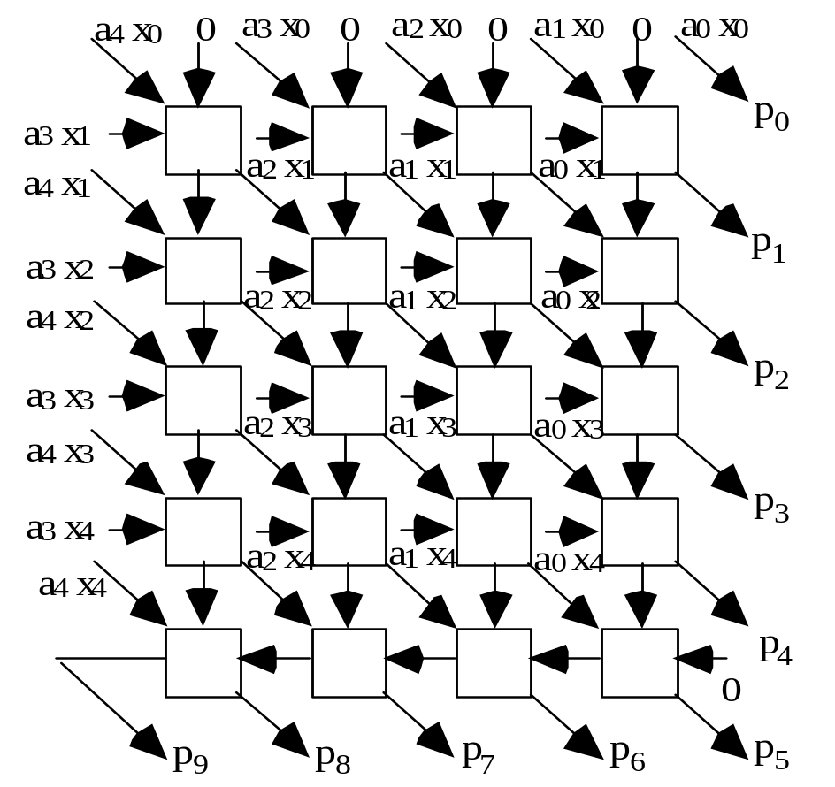
11.5 Array Multipliers
Fig. 11.10 A basic array multiplier uses a one-sided CSA tree and a ripple-carry adder.
Fig. 11.11 Details of a 5 × 5 array multiplier using FA blocks.

Slide 64
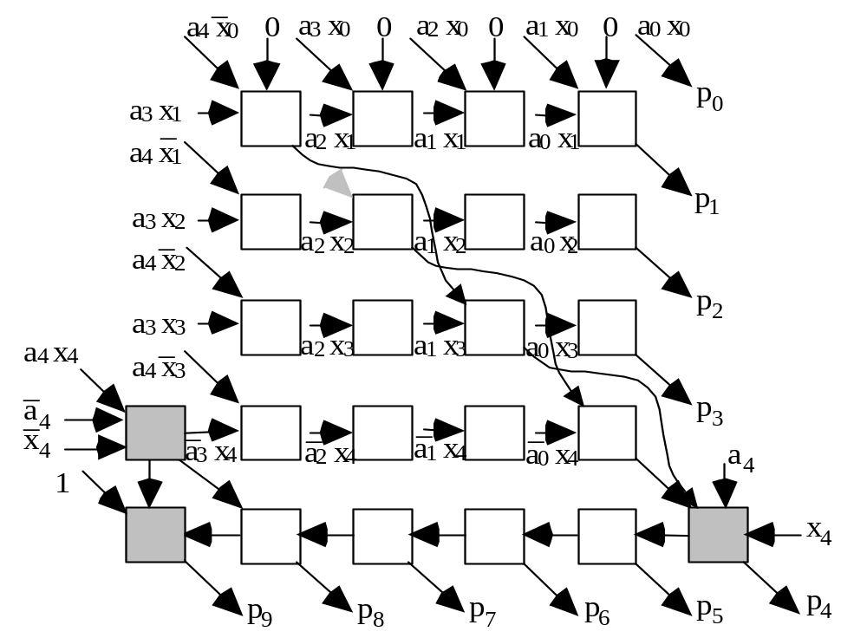
Signed (2’s-complement) Array Multiplier
Fig. 11.12 Modifications in a 5 × 5 array multiplier to deal with 2’s-complement inputs using the Baugh-Wooley method or to shorten the critical path.

Slide 65
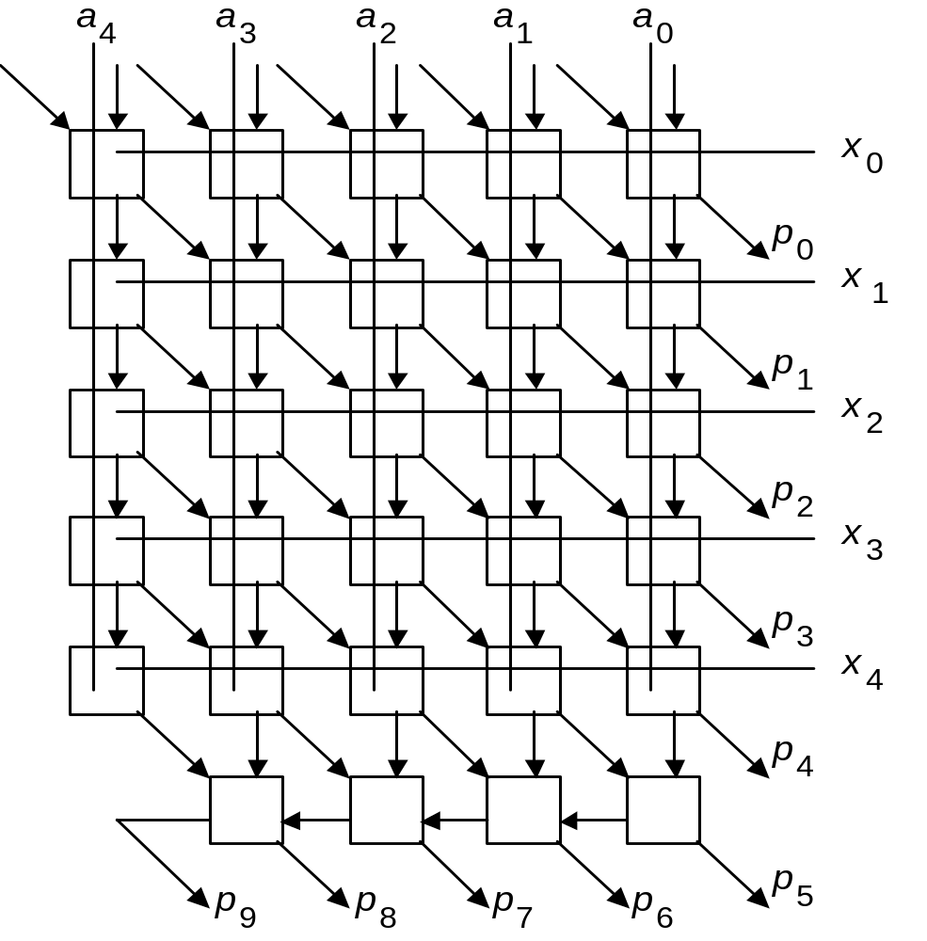
Array Multiplier Built of Modified Full-Adder Cells
Fig. 11.13 Design of a 5 × 5 array multiplier with two additive inputs and full-adder blocks that include AND gates.
FA

Slide 66
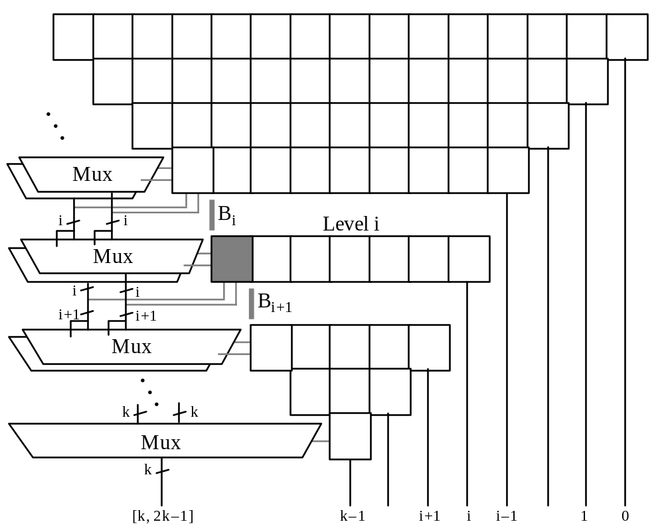
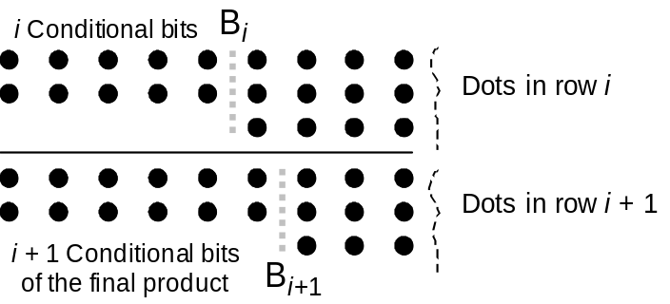
Array Multiplier without a Final Carry-Propagate Adder
Fig. 11.14 Conceptual view of a modified array multiplier that does not need a final carry-propagate adder.
Fig. 11.15 Carry-save addition, performed in level i, extends the conditionally computed bits of the final product.
All remaining bits of the final product produced only 2 gate levels after p_{k–1}

Slide 67
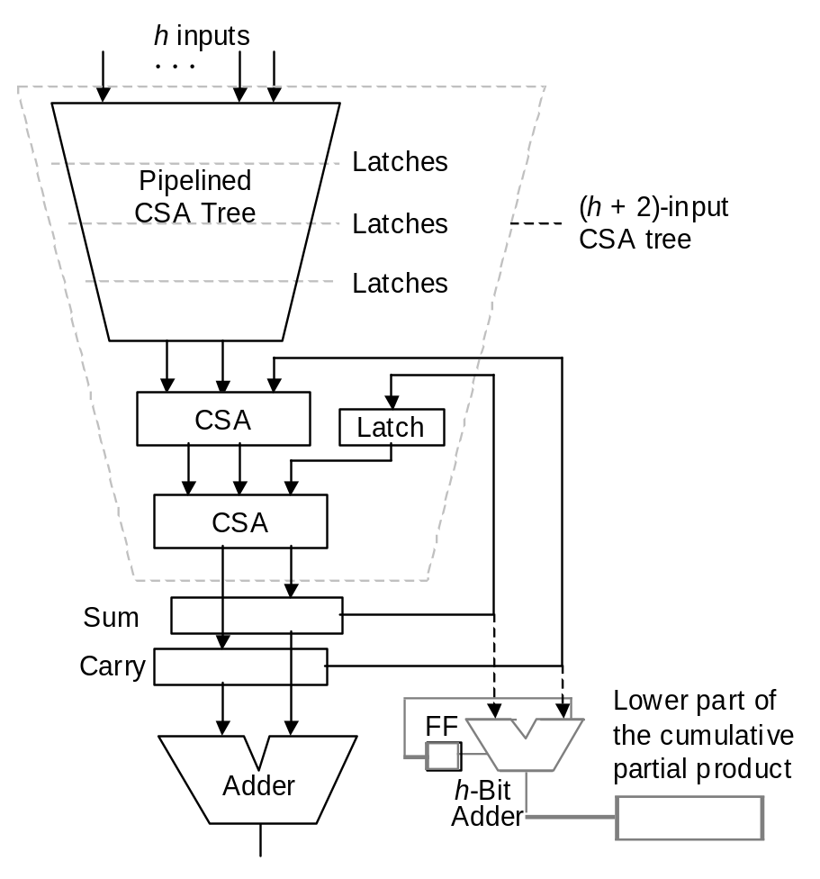
11.6 Pipelined Tree and Array Multipliers
Fig. 11.9 General structure of a partial-tree multiplier.
Fig. 11.16 Efficiently pipelined partial-tree multiplier.

Slide 68
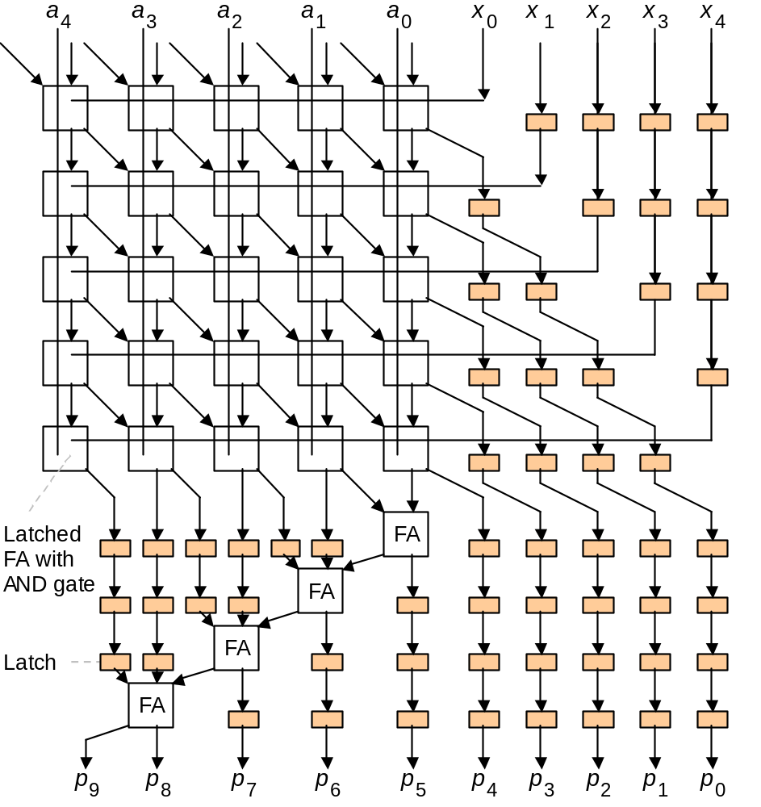
Pipelined Array Multipliers
With latches after every FA level, the maximum throughput is achieved
Latches may be inserted after every h FA levels for an intermediate design
Example: 3-stage pipeline
Fig. 11.17 Pipelined 5 × 5 array multiplier using latched FA blocks.
The small shaded boxes are latches.

Slide 69
12 Variations in Multipliers
Chapter Goals
Learn additional methods for synthesizing
fast multipliers as well as other types
of multipliers (bit-serial, modular, etc.)
Chapter Highlights
Building a multiplier from smaller units
Performing multiply-add as one operation
Bit-serial and (semi)systolic multipliers
Using a multiplier for squaring is wasteful

Slide 70
Variations in Multipliers: Topics
Topics in This Chapter
12.1. Divide-and-Conquer Designs
12.2. Additive Multiply Modules
12.3. Bit-Serial Multipliers
12.4. Modular Multipliers
12.5. The Special Case of Squaring
12.6. Combined Multiply-Add Units

Slide 71
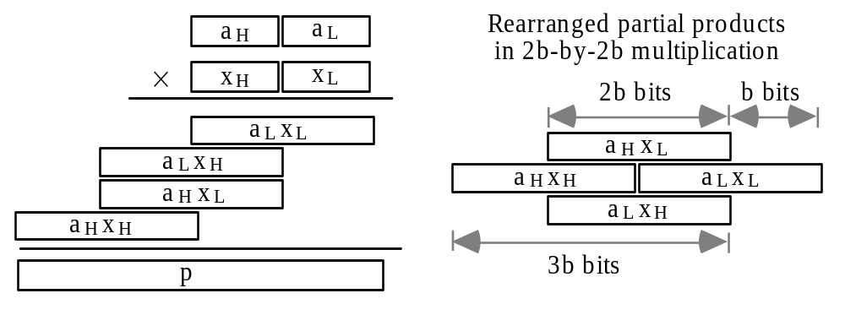
12.1 Divide-and-Conquer Designs
Building wide multiplier from narrower ones
Fig. 12.1 Divide-and-conquer (recursive) strategy for synthesizing a 2b × 2b multiplier from b × b multipliers.

Slide 72
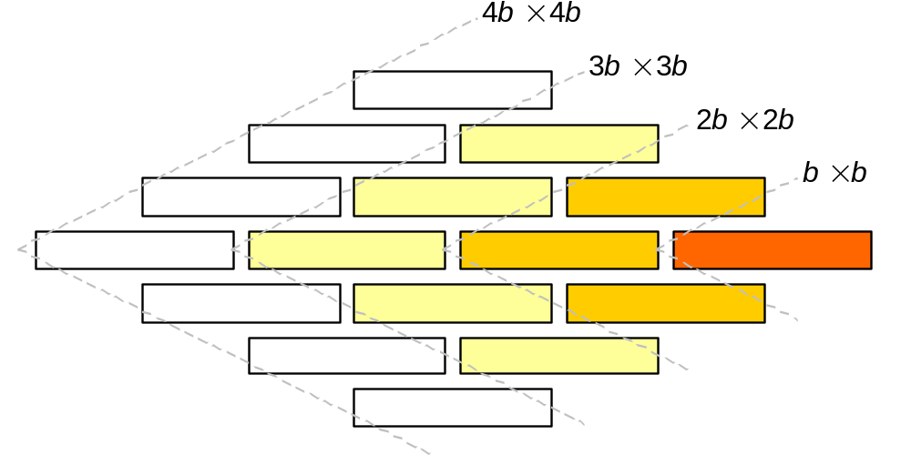
General Structure of a Recursive Multiplier
2b × 2b use (3; 2)-counters
3b × 3b use (5; 2)-counters
4b × 4b use (7; 2)-counters
Fig. 12.2 Using b × b multipliers to synthesize 2b × 2b, 3b × 3b, and 4b × 4b multipliers.

Slide 73
Using b × c, rather than b × b Building Blocks
2b × 2c use b × c multipliers and (3; 2)-counters
2b × 4c use b × c multipliers and (5?; 2)-counters
gb × hc use b × c multipliers and (?; 2)-counters

Slide 74
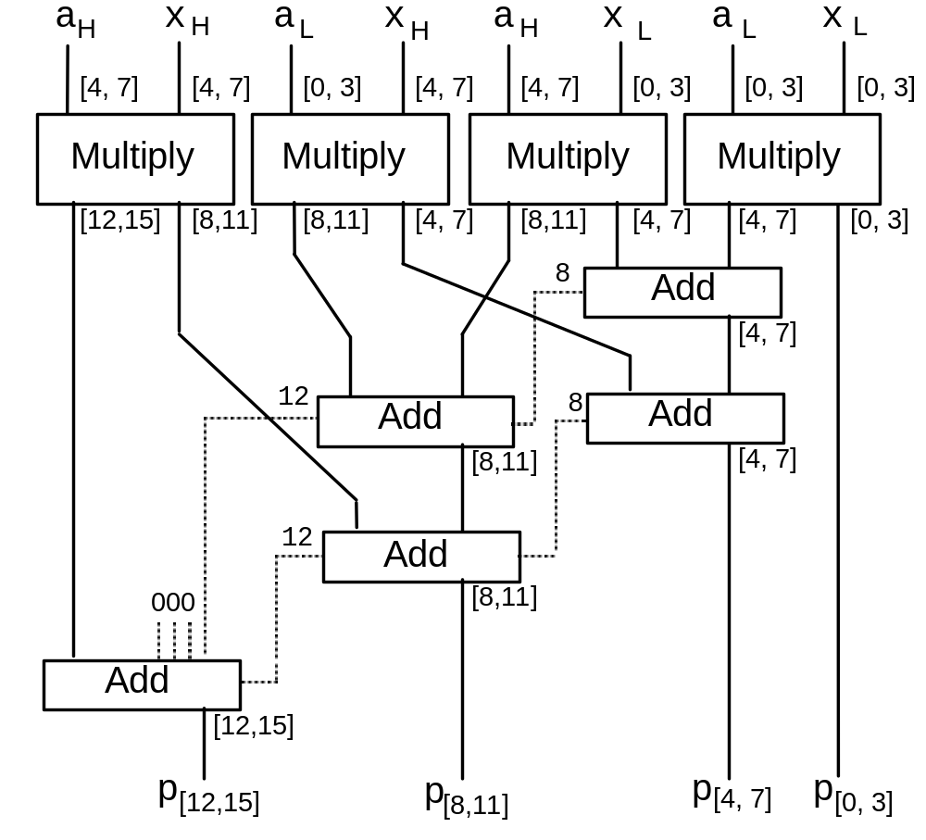
Wide Multiplier Built of Narrow Multipliers and Adders
Fig. 12.3 Using 4 × 4 multipliers and
4-bit adders to synthesize an
8 × 8 multiplier.

Slide 75
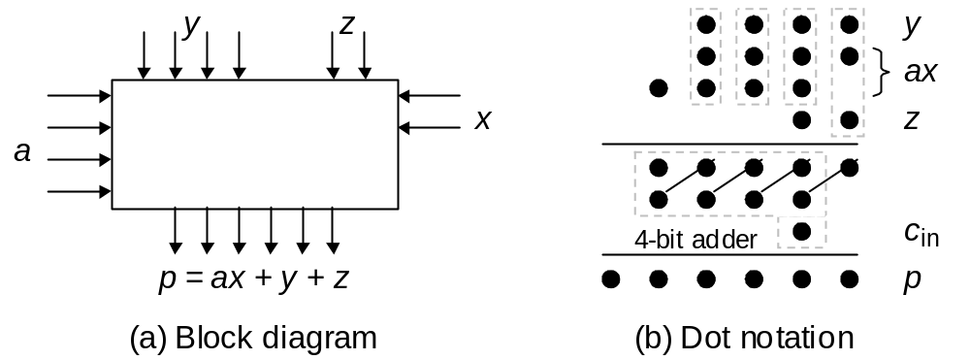
12.2 Additive Multiply Modules
Fig. 12.4 Additive multiply module with 2 × 4 multiplier (ax) plus 4-bit and 2-bit additive inputs (y and z).
b-bit and c-bit multiplicative inputs
b × c AMM b-bit and c-bit additive inputs
(b + c)-bit output
(2^{b} – 1) × (2^{c} – 1) + (2^{b} – 1) + (2^{c} – 1) = 2^{b+c} – 1

Slide 76
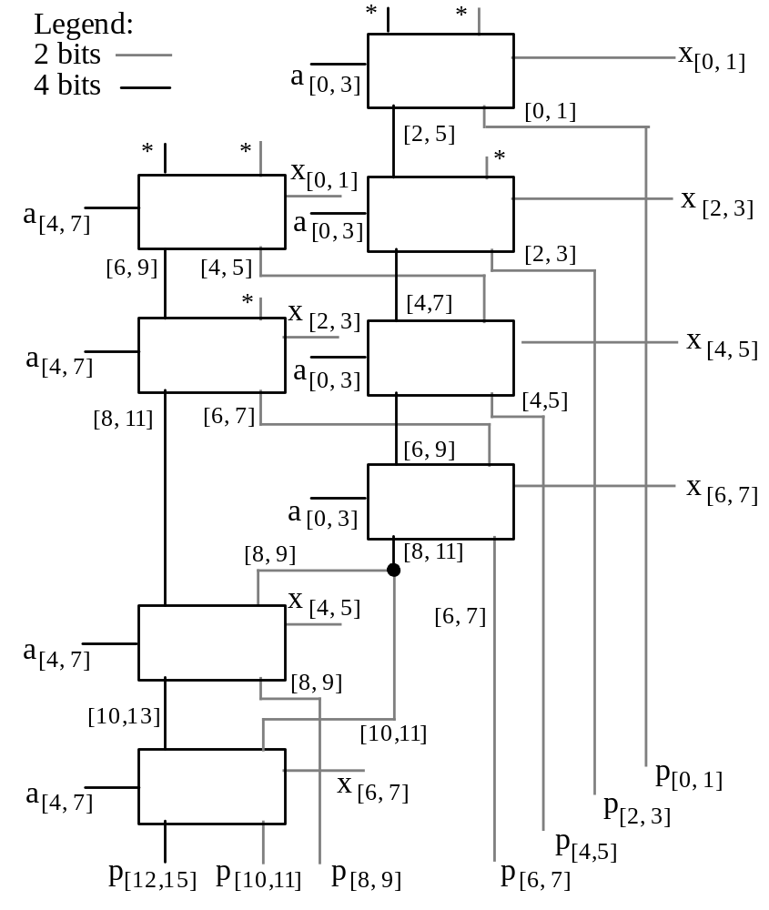
Multiplier Built of AMMs
Understanding an 8 × 8 multiplier built of 4 × 2 AMMs using dot notation
Fig. 12.5 An 8 × 8 multiplier built of 4 × 2 AMMs. Inputs marked with an asterisk carry 0s.

Slide 77
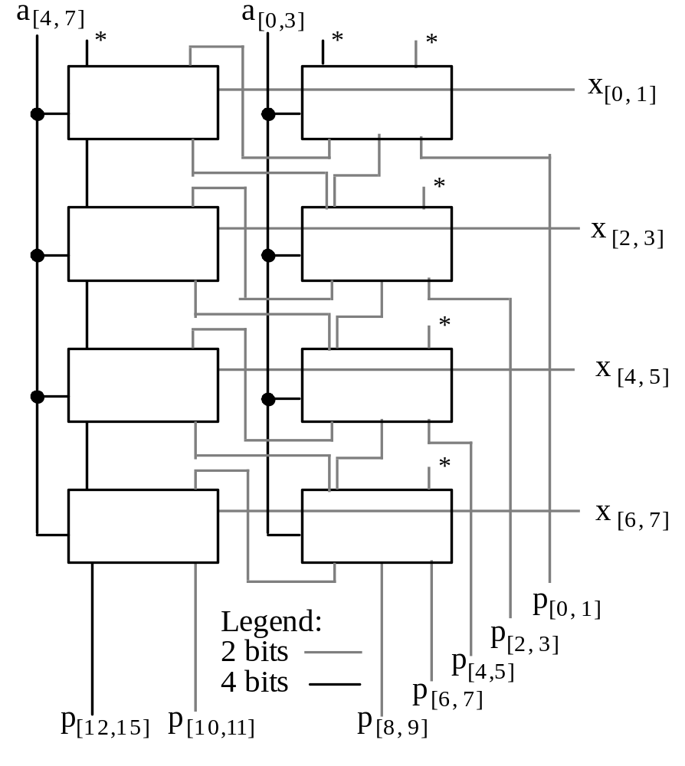
Multiplier Built of AMMs: Alternate Design
This design is more regular than that in Fig. 12.5 and is easily expandable to larger configurations; its latency, however, is greater
Fig. 12.6 Alternate 8 × 8 multiplier design based on 4 × 2 AMMs. Inputs marked with an asterisk carry 0s.

Slide 78
12.3 Bit-Serial Multipliers
Bit-serial adder
(LSB first)
…
x₂
x₁
x₀
FF
…
s₂
s₁
s₀
FA
…
y₂
y₁
y₀
Bit-serial multiplier
…
a₂
a₀
a₁
?
…
(Must follow the k-bit inputs with k 0s; alternatively, view the product as being only k bits wide)
p₂
p₀
p₁
…
x₂
x₀
x₁
What goes inside the box to make a bit-serial multiplier?
Can the circuit be designed to support a high clock rate?

Slide 79
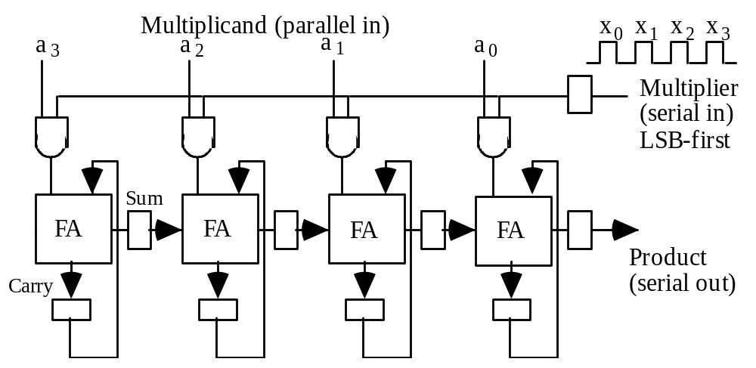
Semisystolic Serial-Parallel Multiplier
Fig. 12.7 Semi-systolic circuit for 4 × 4 multiplication in 8 clock cycles.
This is called “semisystolic” because it has a large signal fan-out of k (k-way broadcasting) and a long wire spanning all k positions

Slide 80
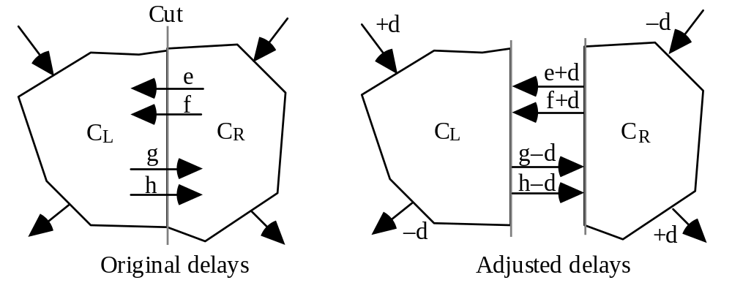
Systolic Retiming as a Design Tool
A semisystolic circuit can be converted to a systolic circuit via retiming, which involves advancing and retarding signals by means of delay removal and delay insertion in such a way that the relative timings of various parts are unaffected
Fig. 12.8 Example of retiming by delaying the inputs to C_{L} and advancing the outputs from C_{L} by d units

Slide 81
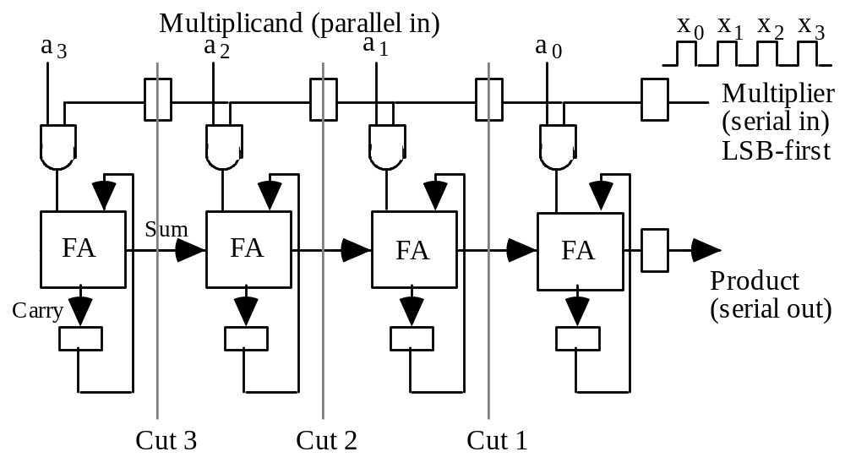
A First Attempt at Retiming
Fig. 12.7
Fig. 12.9 A retimed version of our semi-systolic multiplier.

Slide 82
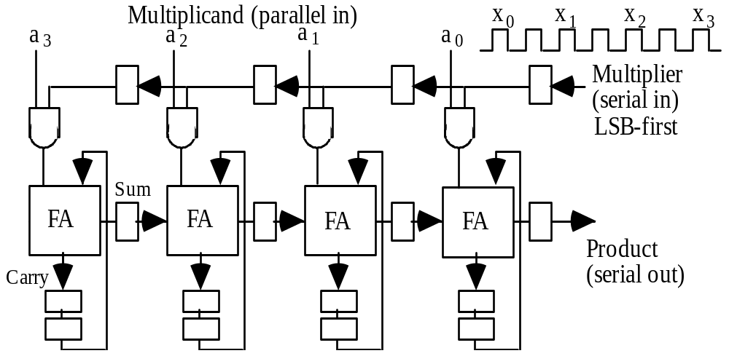
Deriving a Fully Systolic Multiplier
Fig. 12.7
Fig. 12.9 A retimed version of our semi-systolic multiplier.

Slide 83
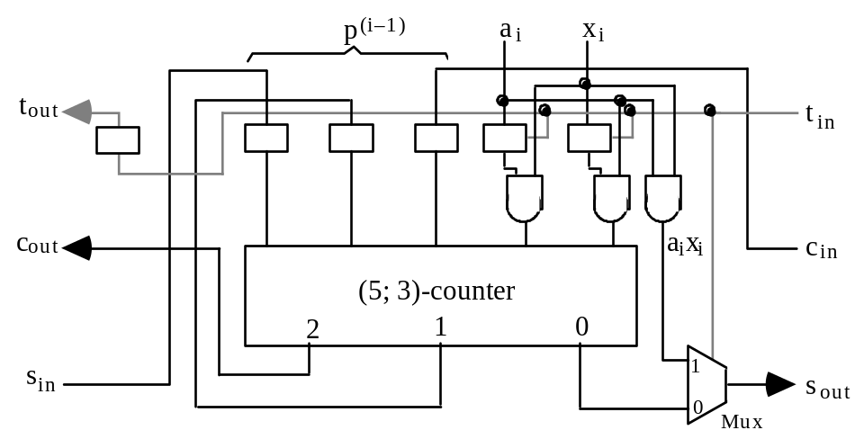


A Direct Design for a Bit-Serial Multiplier
Fig. 12.11 Building block for a latency-free bit-serial multiplier.
Fig. 12.12 The cellular structure of the bit-serial multiplier based on the cell in Fig. 12.11.
Fig. 12.13 Bit-serial multiplier design in dot notation.

Slide 84


12.4 Modular Multipliers
Fig. 12.14 Modulo-(2^{b} – 1) carry-save adder.
Fig. 12.15 Design of a
4 × 4 modulo-15 multiplier.

Slide 85


Other Examples of Modular Multiplication
Fig. 12.16 One way to design of a 4 × 4 modulo-13 multiplier.
Fig. 12.17 A method for modular multioperand addition.

Slide 86

12.5 The Special Case of Squaring
x₁x₀
–x₁x₀
Fig. 12.18 Design of a 5-bit squarer.

Slide 87

12.6 Combined Multiply-Add Units
Multiply-add
versus
multiply-accumulate
Multiply-accumulate units often have wider additive inputs
Fig. 12.19 Dot-notation representations of various methods for performing a multiply-add operation in hardware.

